Slide 1
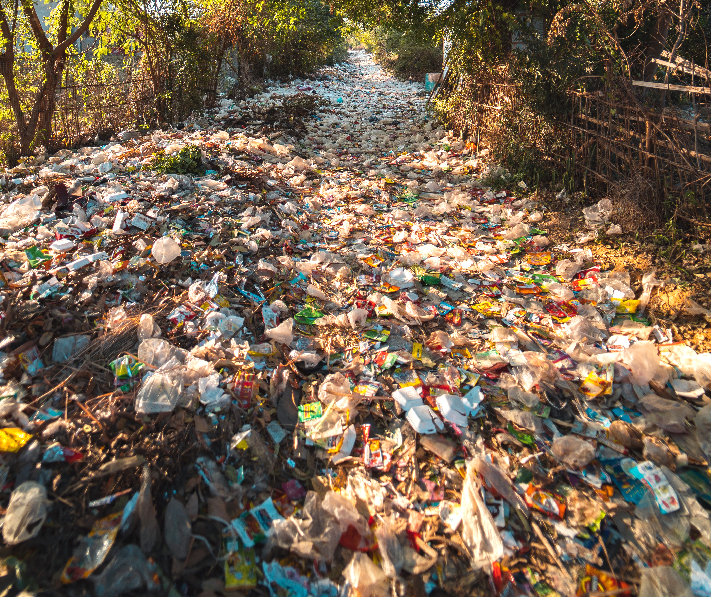

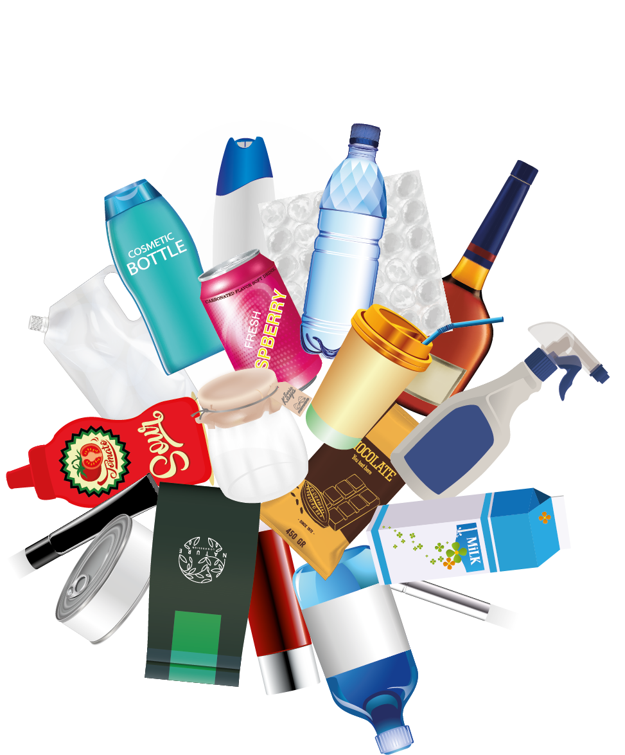
Packaging
Pandemic!
The Problem
with Packaging
/////////////////////////////////////

Slide 2
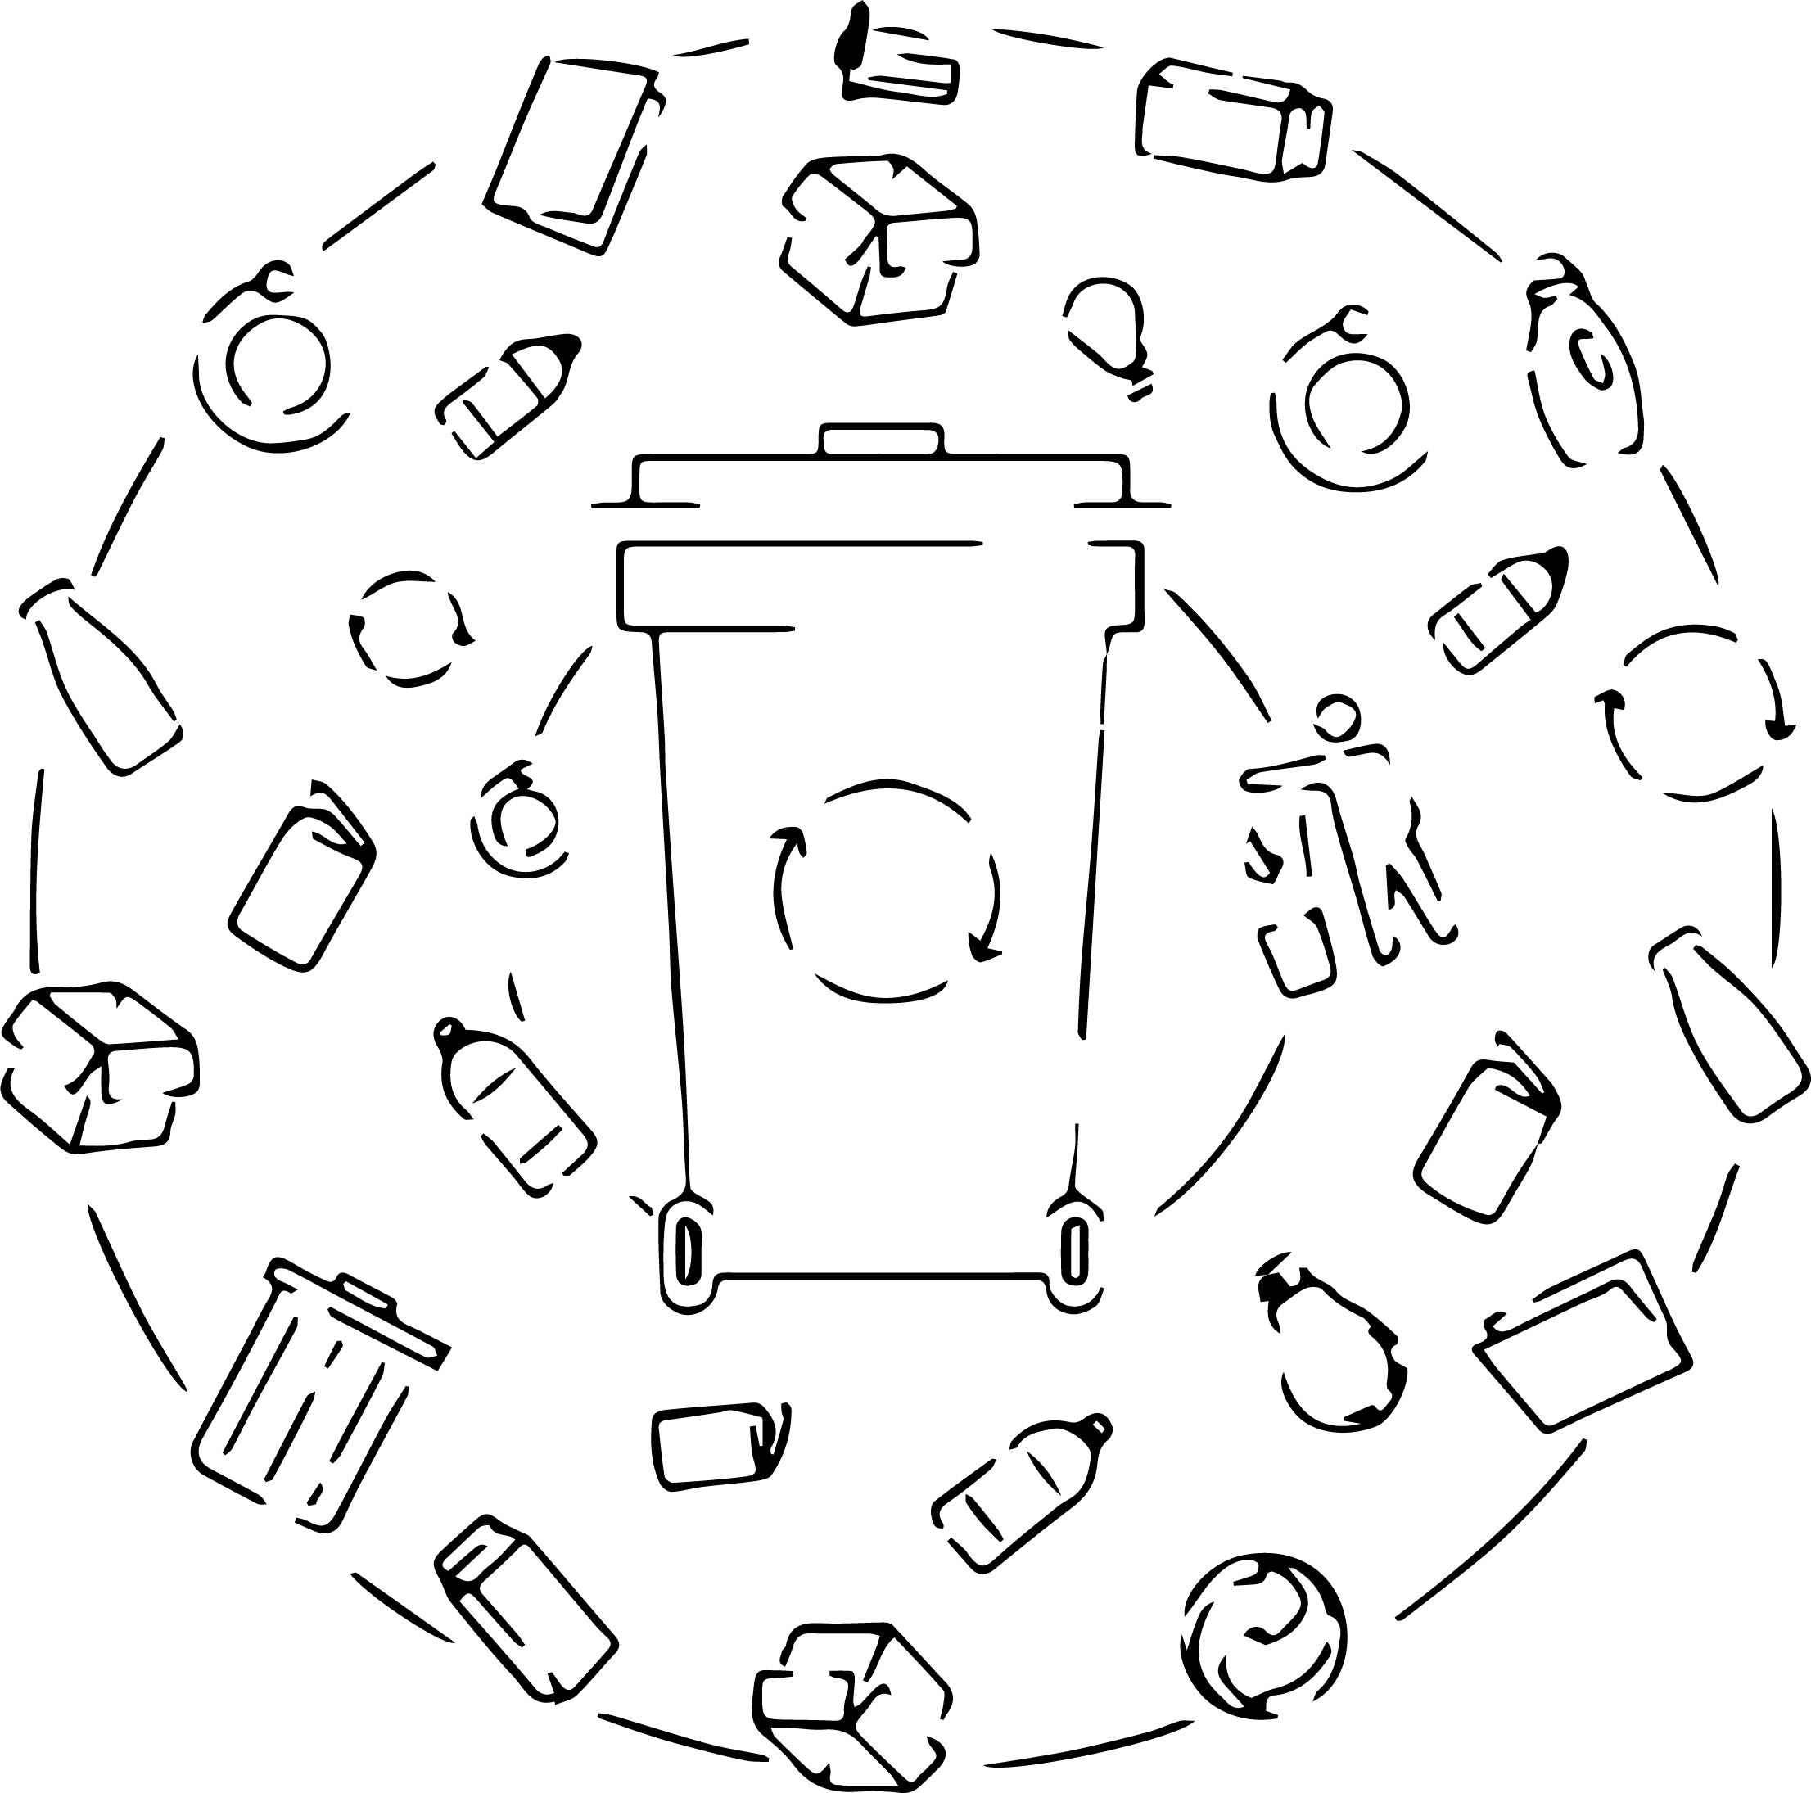
Context
Packaging is a huge industry in itself, sometimes separate from the product that is being packaged.
Packaging can serve many uses BUT can also cause many problems, particularly as we have switched to plastics and other materials that impact the environment.
Bayer is committed to reversing
some of that trend and to a
more sustainable future.

Slide 3

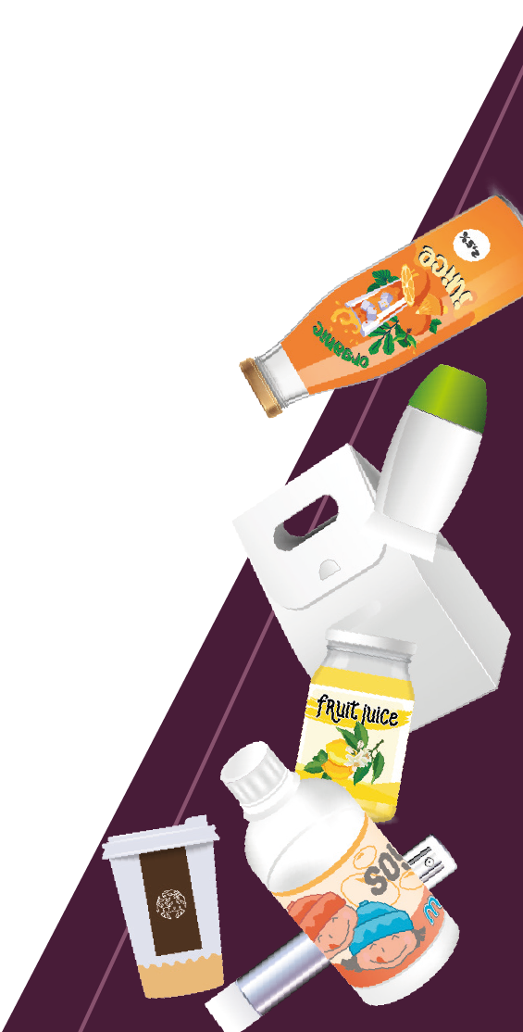
Lets start by talking about why we need packaging?
// In small groups try and think of answers
to the question:
// “Why is packaging useful?”
// It will probably help if each person in the
group thinks of a product they like or use
regularly. Start by telling everyone else
in the group the product you have
thought of! (No duplicates…)
// For each product, try and briefly answer
the questions opposite.
// How is packaging useful for the
consumer / you?
// How is packaging useful for the
manufacturer / producer?
// How is packaging useful for the
retail outlet/ transporter?
Hopefully you will come up with some themes, but also see that there is crossover between the different groups’ needs.
/// Bayer 16:9 /// July 2022

Slide 4

The role of packaging
Protect the product
Make the product visible
Preserve the product (shelf-life)
Provide consumer convenience
Reduce product waste
/// Bayer 16:9 /// July 2022

Slide 5
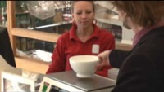
The role of packaging
/// Bayer 16:9 /// July 2022

Slide 6
The problem(s) with packaging!
We have seen that packaging is useful
and often necessary, but it also comes
with many problems. Can
you think of what some of
these may be?
Only around 67% of our packaging waste in the UK is recycled or recovered. This the same as in 2019 and only 3% better than in 2010
The UK only recycles or reuses around 50% of waste glass compared to 90% in some European countries
84% of all corrugated cardboard is recycled in the UK – that adds up to about 2 million tonnes saved from landfill every year!
Recycling a single aluminium can will save enough energy to power a TV for up to three hours
Plastic packaging in the UK makes up nearly 70% of our total plastic waste.
9.2 billion tonnes of plastic has been produced worldwide since 1950 and over half of this has gone into waste.
/// Bayer 16:9 /// July 2022

Slide 7
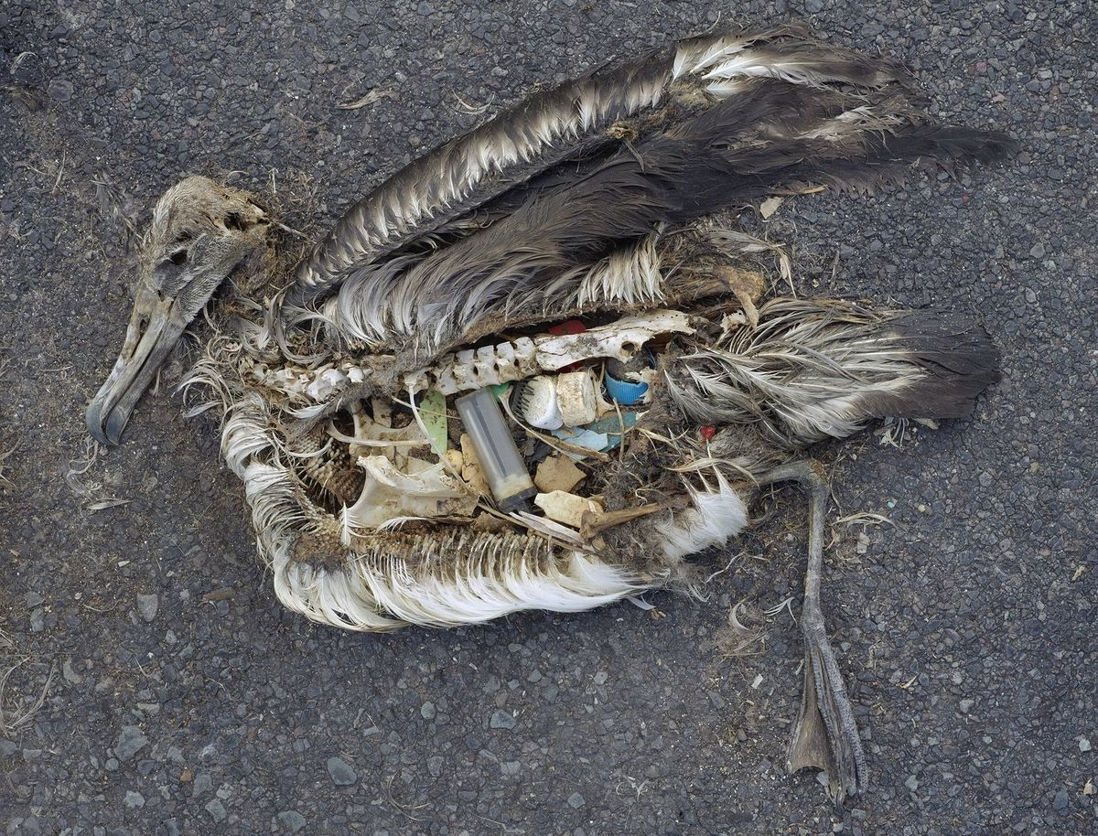
The problem with packaging – Plastic!
Researchers have estimated that 12 million tonnes of plastic enters the oceans: that is equivalent to a truckload every minute!
Plastic blown out of landfill sites and bottles that are simply discarded find their way into drains, streams and rivers; eventually making their way to the seas and oceans.
The UK has one of the largest ratios of plastic production per person in the world
(35kg per person!)
Other ways plastic can get into the ocean is as microplastics from washing clothes and other industrial processes.
This polluting plastic can severely affect
wildlife and the food chain, eventually
finding its way back into humans.
The unaltered stomach contents of a dead albatross chick photographed on Midway Atoll National Wildlife Refuge in the Pacific in September 2009 include plastic marine debris fed the chick by its parents.
© Chris Jordan / CC BY 2.0
/// Bayer 16:9 /// July 2022

Slide 8
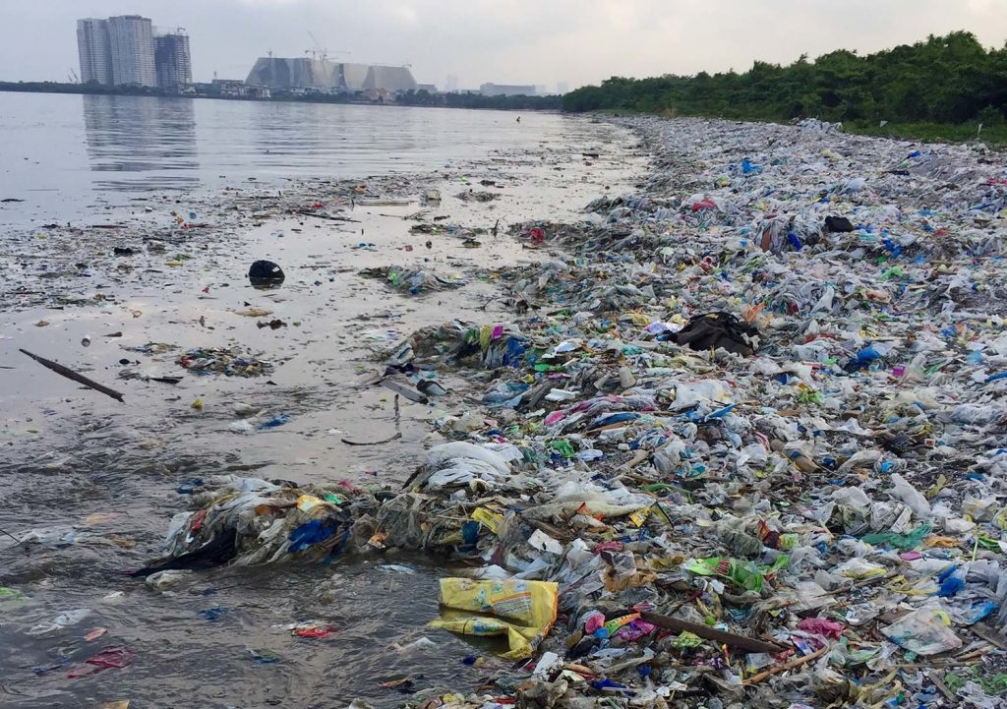
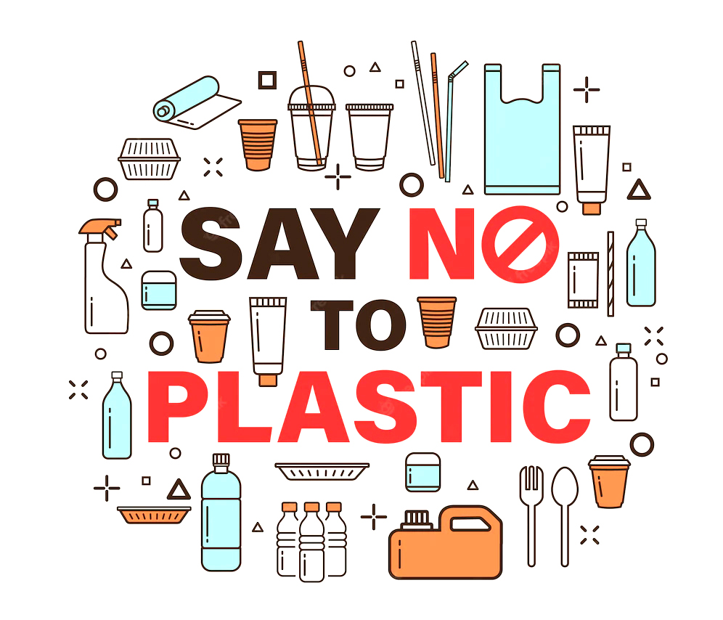
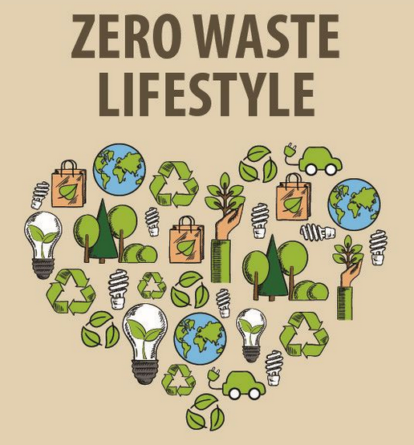
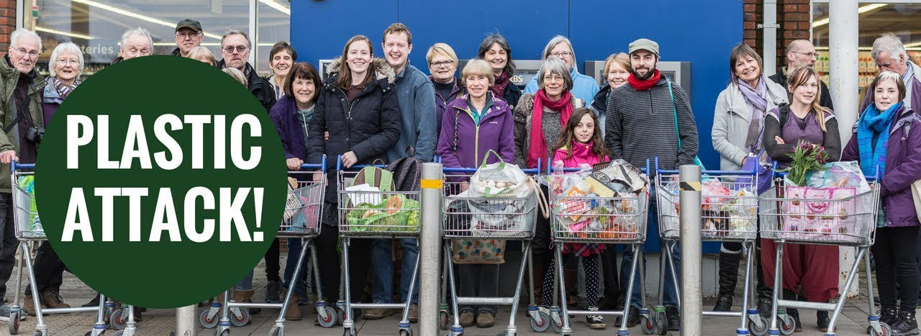
Recently many people - consumers and producers - have begun to question our reliance on single use plastics and other materials that are hard to recycle or reuse.
/// Bayer 16:9 /// July 2022

Slide 9
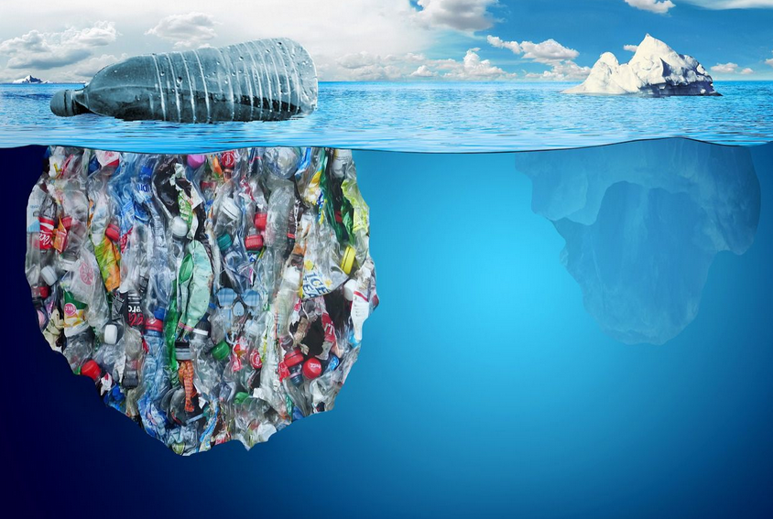
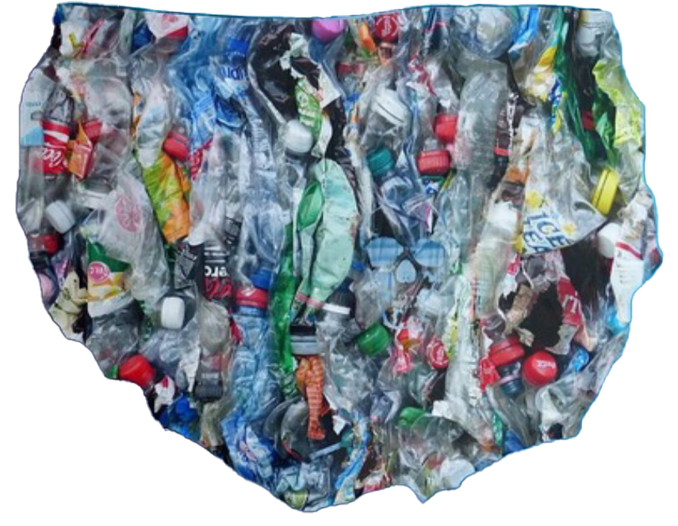

Visible part for the consumer
/// Bayer 16:9 /// July 2022

Slide 10
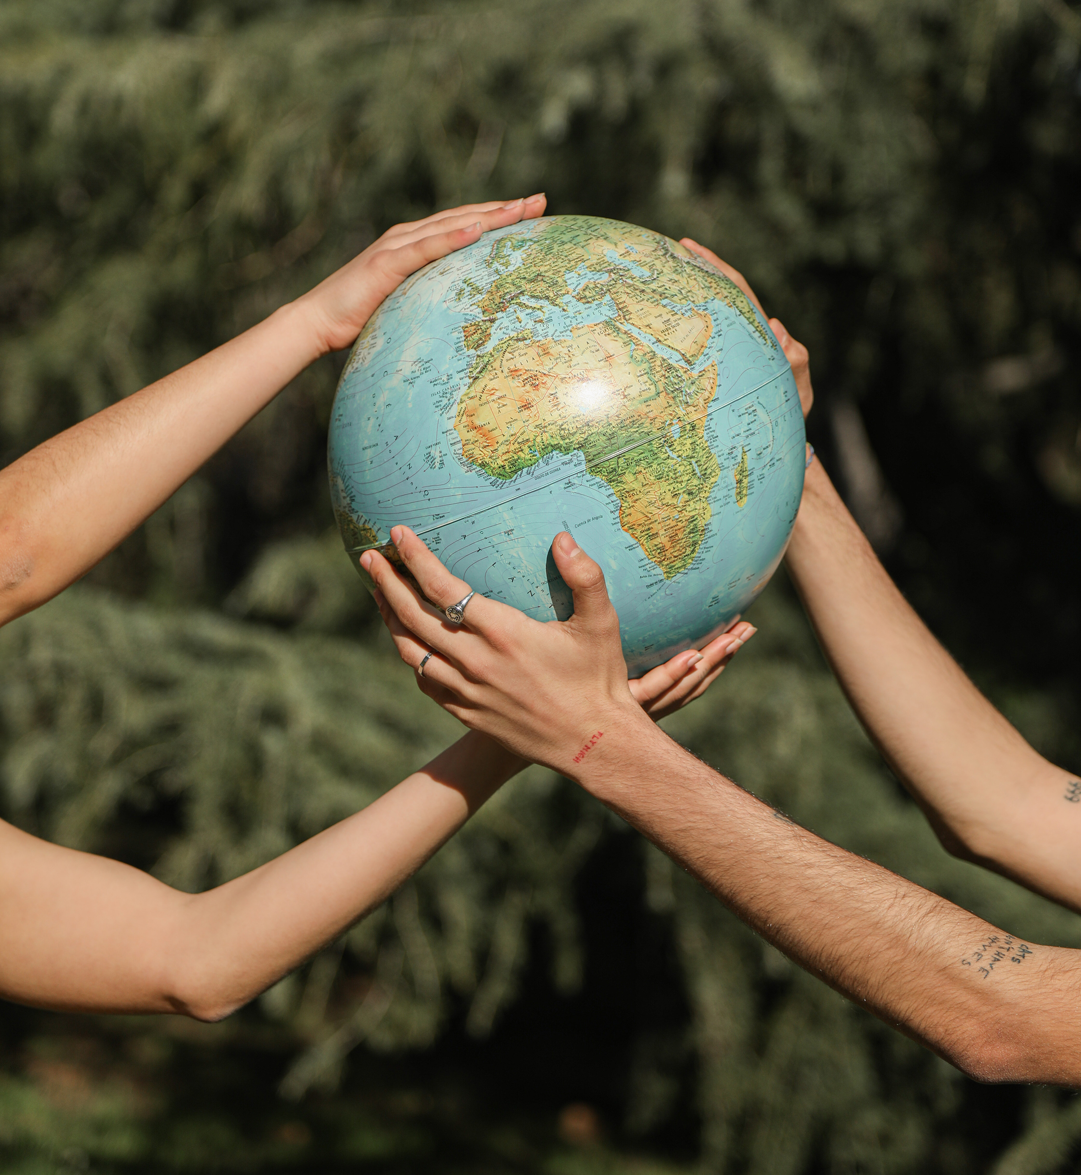
Sustainability
This is a word that can have different meanings to different people so can be defined in a number of ways
// Activity Information
// The Hidden Pandemic – Food Waste
// Quick Quiz!
// Driving Change
// Scientific Solutions
// Societal Solutions
// The Mission!
// Sustainability means meeting our
own needs without preventing future
generations being able to meet
theirs.
// For a company this can mean
continuing to be profitable without
harming the environment or its
customers.
// For an individual this may mean
small changes they can
make to help look after
the planet.

Slide 11
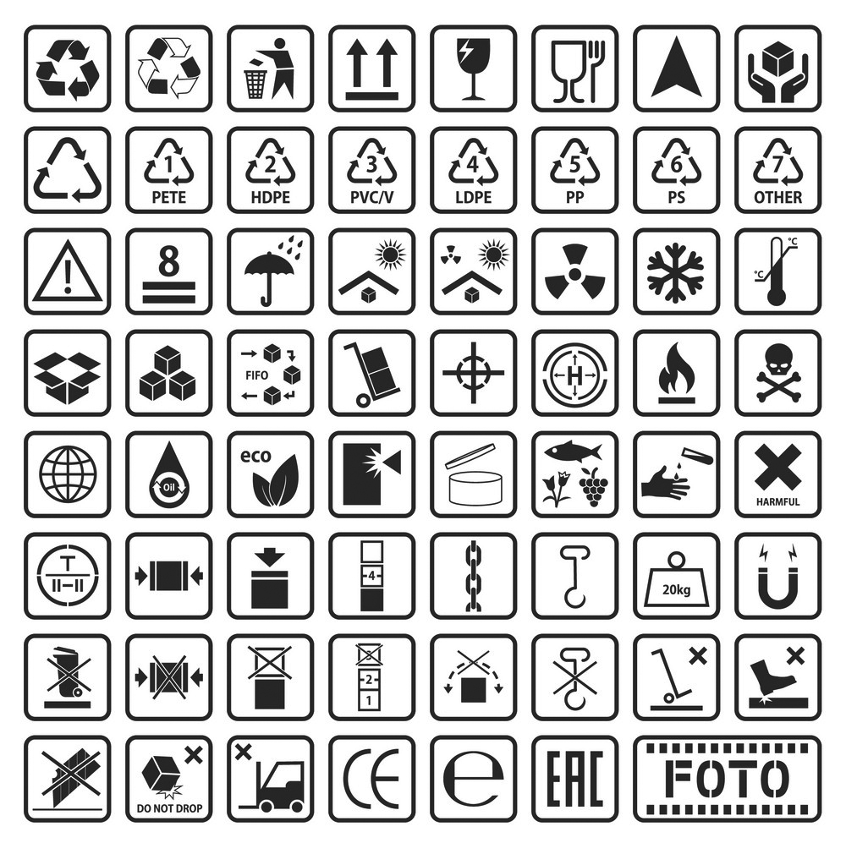
So many words, so many symbols!
// There are many terms and logos
used when describing packaging
materials and how good or bad they
are for our environment.
// Sometimes two words are used for
the same idea!
// Sometimes the wrong words are
used!
// Let’s start with a quiz to see which
ones you have come across before.
/// Bayer 16:9 /// July 2022

Slide 12
What does “biodegradable” mean?
// A biodegradable material breaks down into
many microscopic fragments.
// A biodegradable material eventually
decays naturally and in a way that is not
harmful to the environment.
// A biodegradable material builds up in the
environment over time.
// On its own the term can be
meaningless as most materials will
biodegrade given time.
// There are no defined time limits for
the term “biodegradable,” thus the
use of this word can be potentially
confusing to the general public
both in terms of where to
dispose of it and what
happens to it once it has been
discarded.
/// Bayer 16:9 /// July 2022

Slide 13

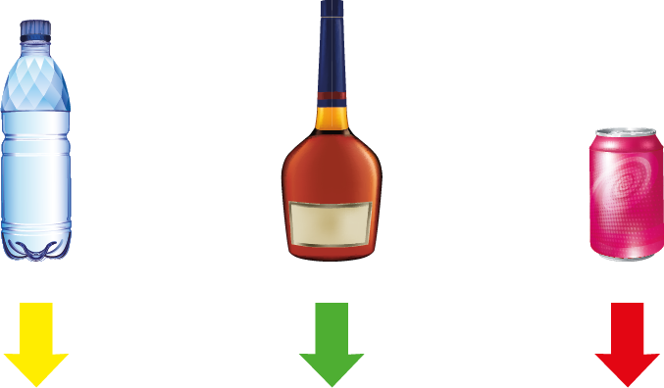
Which would be the quickest to break down
1000 years
1,000,000 years
200 years
Conditions are important to encourage biodegradability. Products that will
biodegrade in nature or in home compost heaps may not biodegrade in landfills,
where there is not enough bacteria, light and water to move the process along.
/// Bayer 16:9 /// July 2022

Slide 14
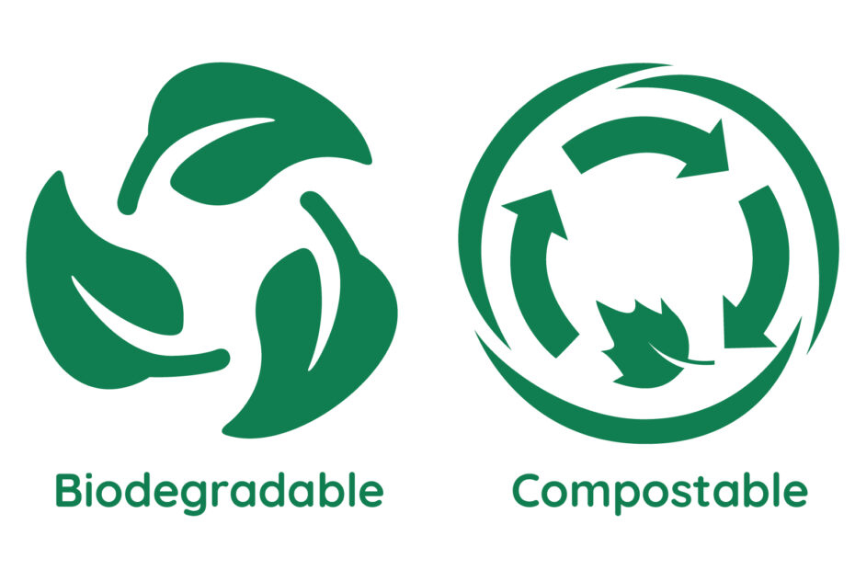
Is “compostable” the same as “biodegradable”?
// For a material to be considered as
100% compostable, it must be
made from organic materials that break
down into completely non-toxic
components. Namely water, biomass
and carbon dioxide. These non-toxic
components must be guaranteed not to
harm the environment.
(source: Polystar plastics website)
// Biodegradable materials can take
years to break down and can leave
toxic residues.
// Biodegradable materials can take longer
than compostable materials to break down
entirely.
// The two words are completely
interchangeable.
// Biodegradable breaks down quicker than
compostable materials.
/// Bayer 16:9 /// July 2022

Slide 15
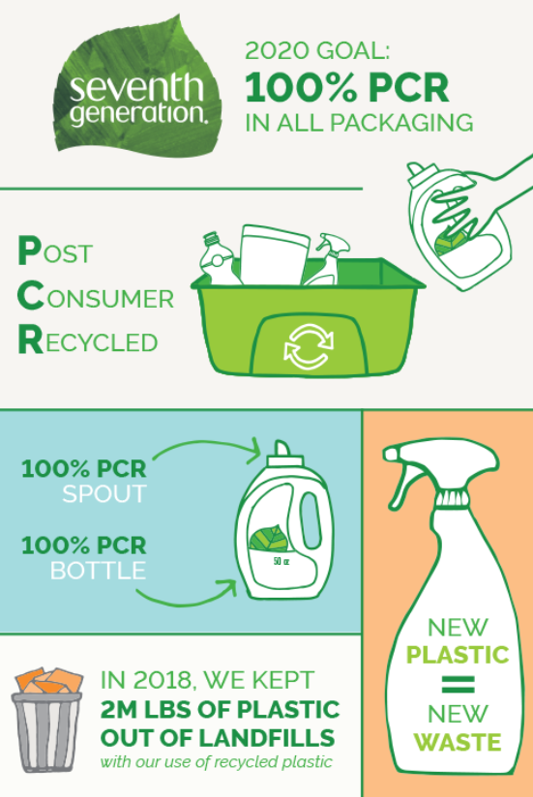
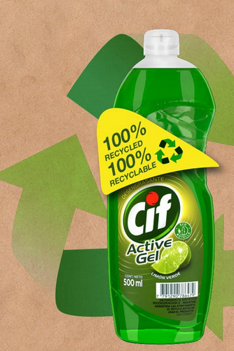
Are “recyclable” and “recycled” the same?
Yes
No
// Recyclable:
the packaging can be recycled
after its normal use by consumer
and after suitable selective
waste sorting
// Recycled:
the packaging contains already
recycled material (PCR)
/// Bayer 16:9 /// July 2022

Slide 16
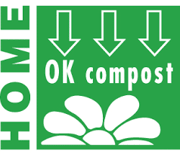

Can all “compostable” material be composted in a home composter?
// Yes, but only with special treatments
// Yes, all of them can
// No, only some of them
// Only those showing the Home
Compostable logo will break down in
a home compost bin
// Packaging with the compostable logo
needs the higher temperature and
conditions of an industrial
composting facility
/// Bayer 16:9 /// July 2022

Slide 17
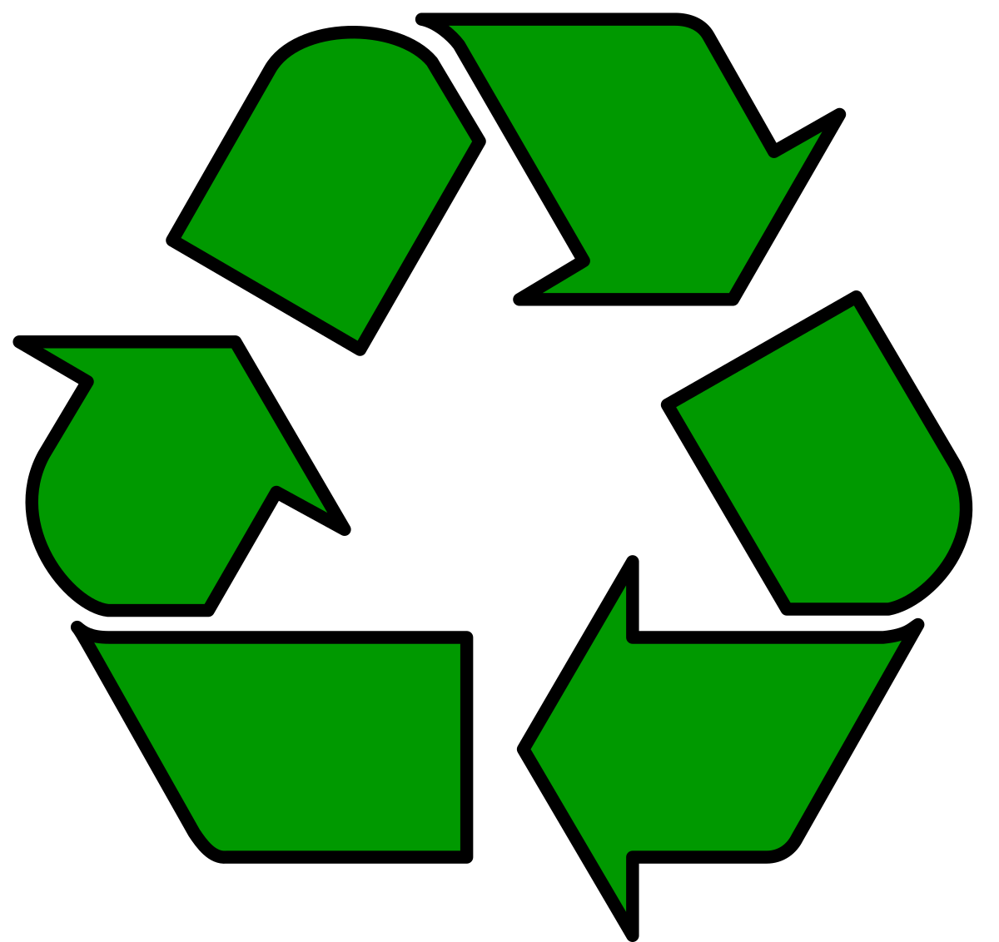

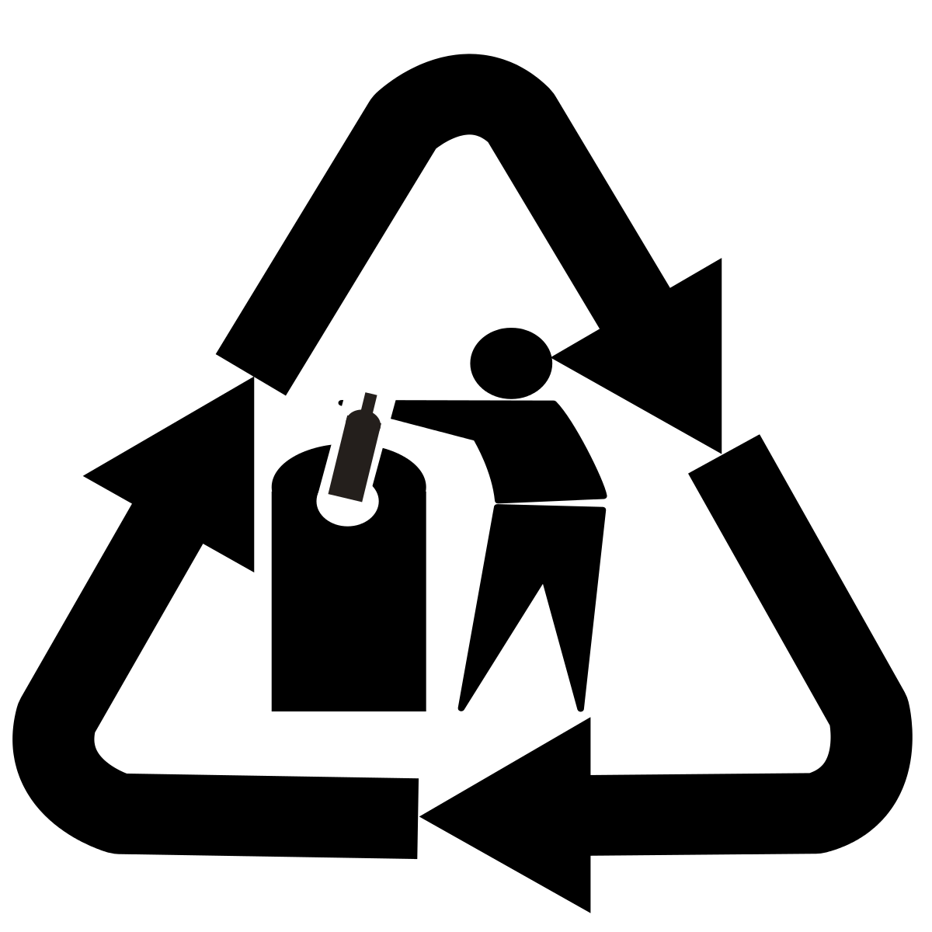
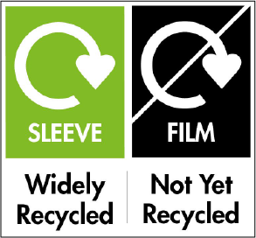
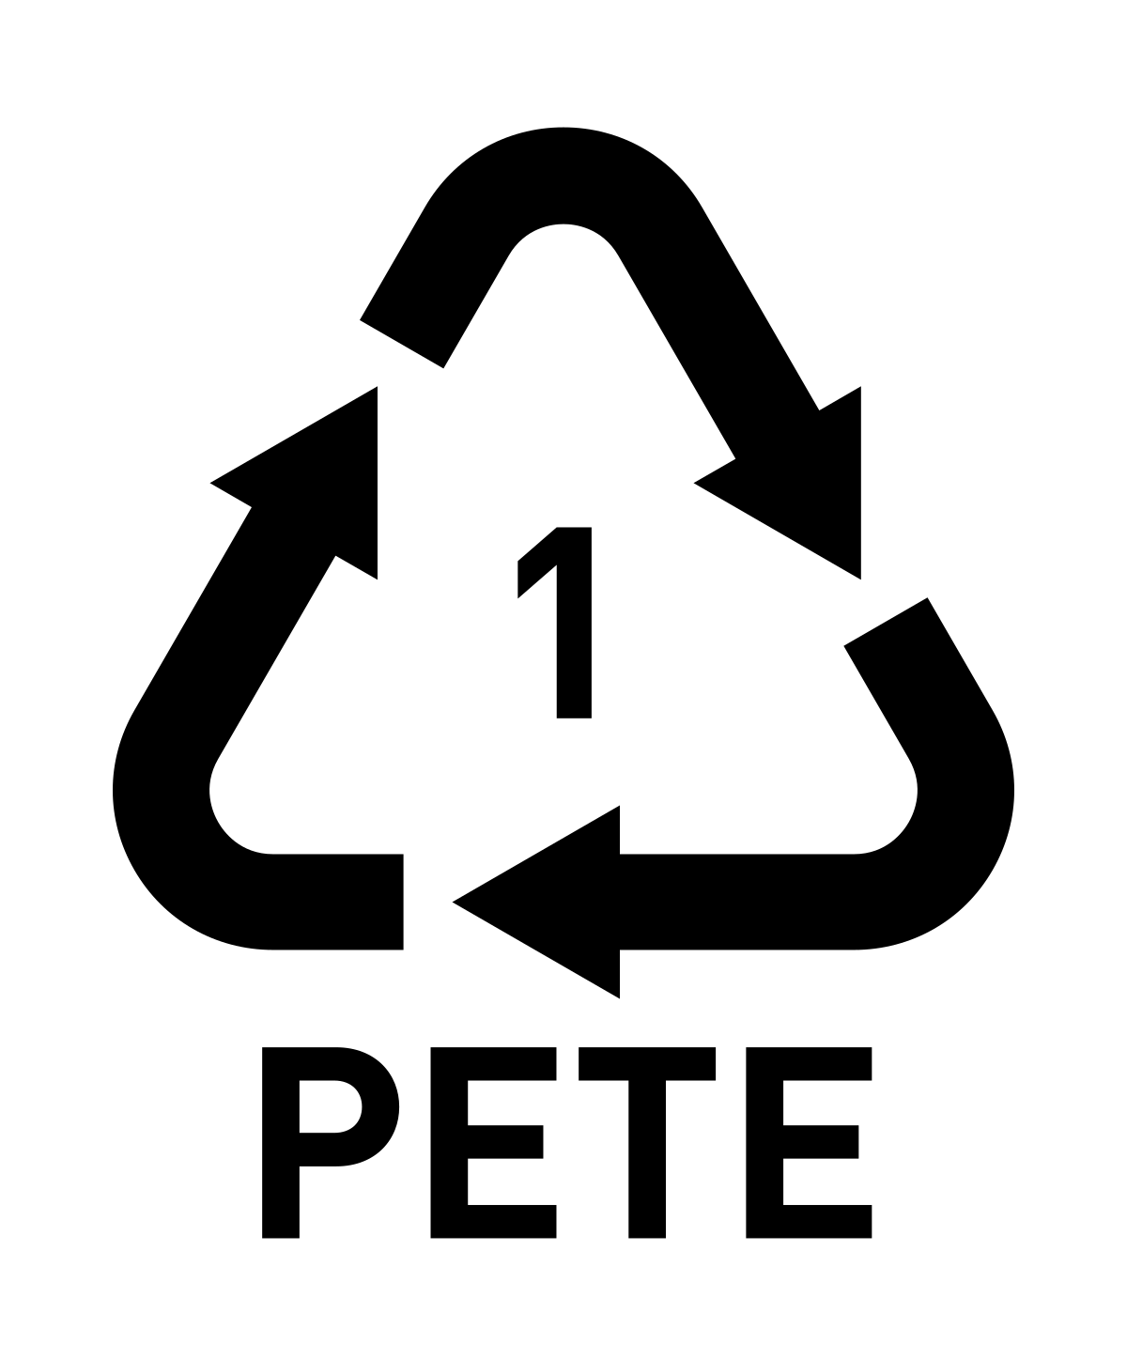


Let’s recycle a symbol – What do they all mean?
The Mobius Loop – This means an item can technically be recycled but not that it has been recycled or that it will be accepted for recycling.
On Paper and Cardboard – The Forest Stewardship Council (FSC) logo means that in item has been made using wood from well managed forests.
Glass Recycling – Simply asking you to put your glass bottle in a suitable recycling bin. In many countries glass is reused in preference to recycling.
Widely Recycled – This tells you that the material is collected for recycling by at least 75% of UK authorities. Often comes with extra instructions.
The Green Dot – Possibly the most misleading as all it means is that the producer has paid money towards the recovery and recycling of the packaging in Europe.
Plastic Resin Code – This tells you what type of plastic the packaging is made from. There are 7 codes.

Slide 18
R
Sustainability
REMOVE
The 4 R’s
R
We have talked about recycling but this is only one of the 4 R’s of sustainability.
These are:
// REMOVE
// REDUCE
// REUSE
// RECYCLE
REDUCE
R
REUSE
R
RECYCLE

Slide 19
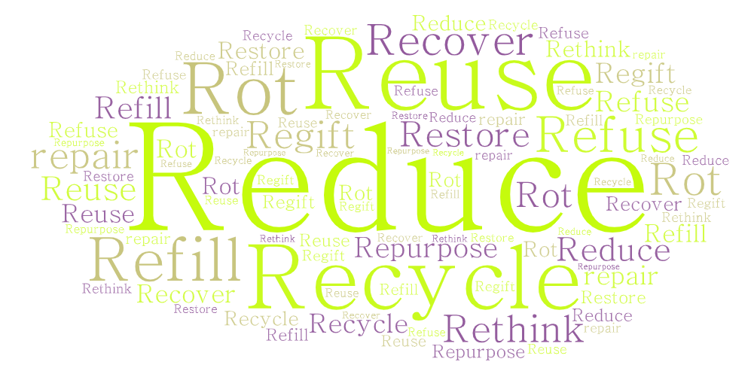
Sustainability The 4 R’s
(or sometimes more)
// We have talked about recycling but this is
only one of the 4 R’s of sustainability
The first three R’s are generally agreed upon:
// REDUCE
// REUSE
// RECYCLE
The 4th R depends who you are
talking to: Environmentalists often
use REFUSE
Industrialists mean RECOVER
It could even be used for ROT,
REPAIR, REMOVE or
REPURPOSE

Slide 20
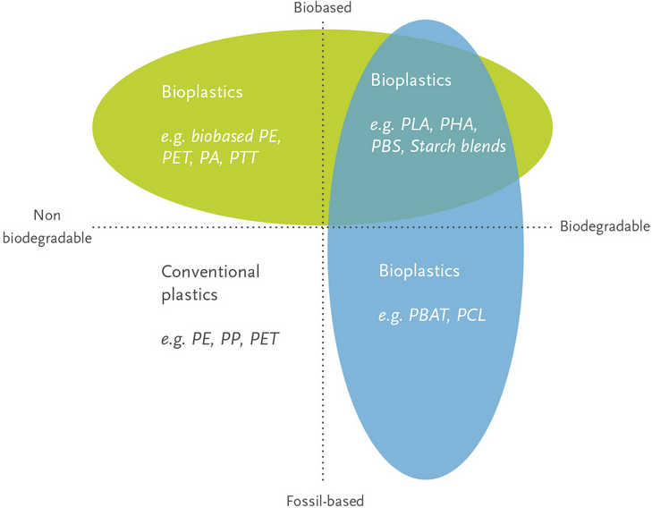
Are bio-sourced plastic products necessarily biodegradable
Yes
No
/// Bayer 16:9 /// July 2022

Slide 21
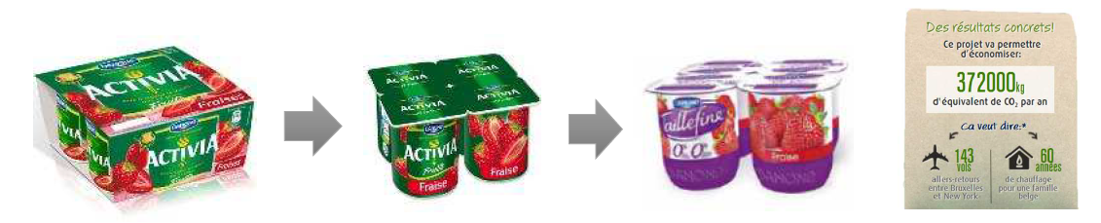
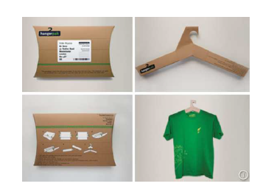
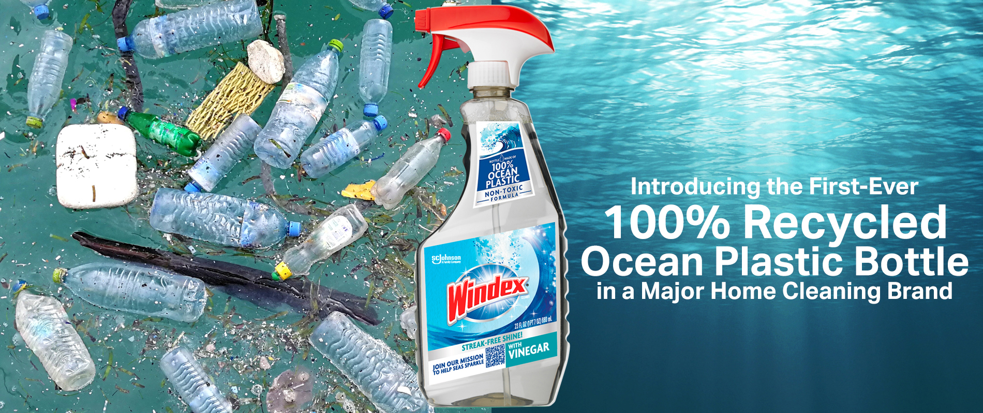
What others do …
/// Bayer 16:9 /// July 2022

Slide 22
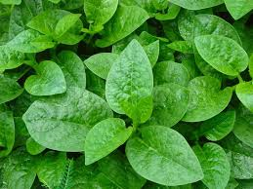

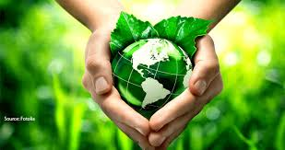
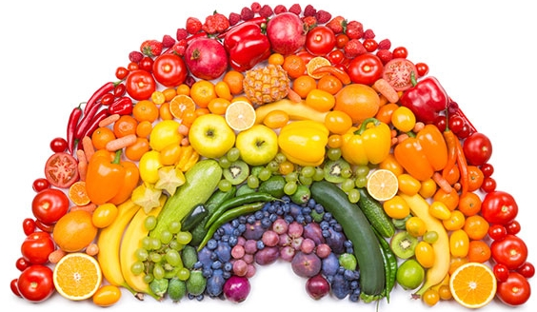

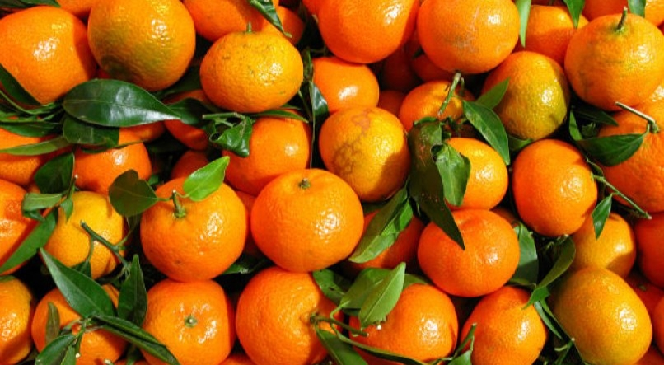

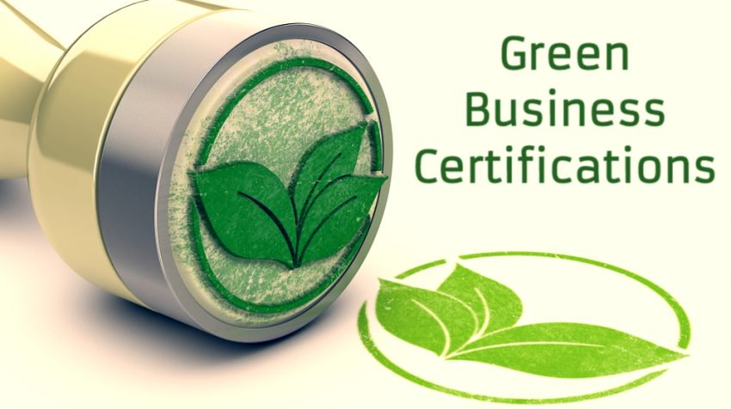
Thank you
/////////////////////////////////////

