Slide 1
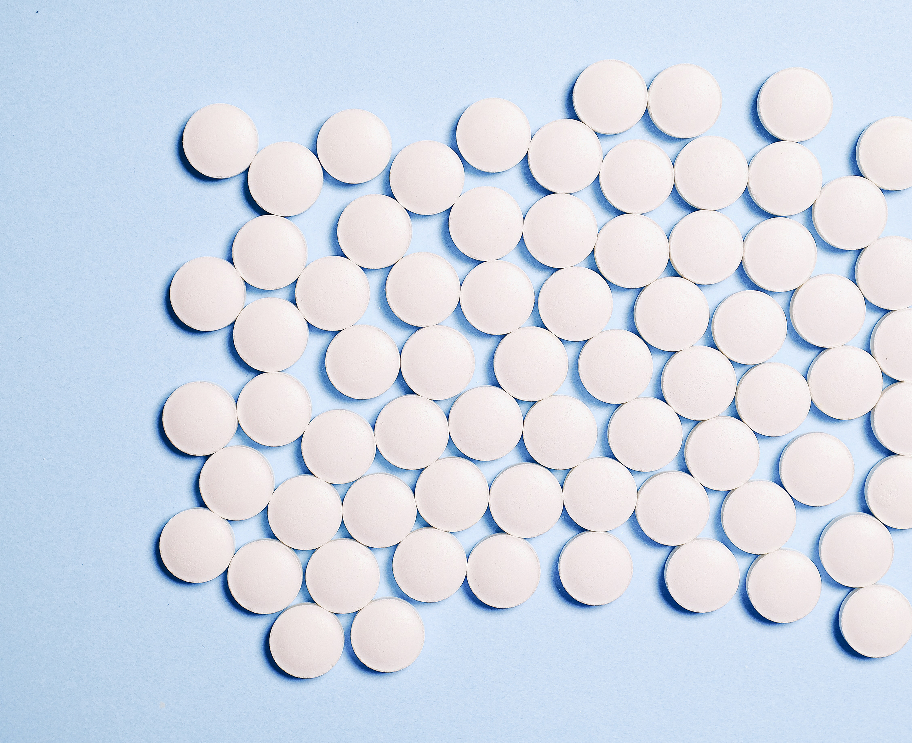
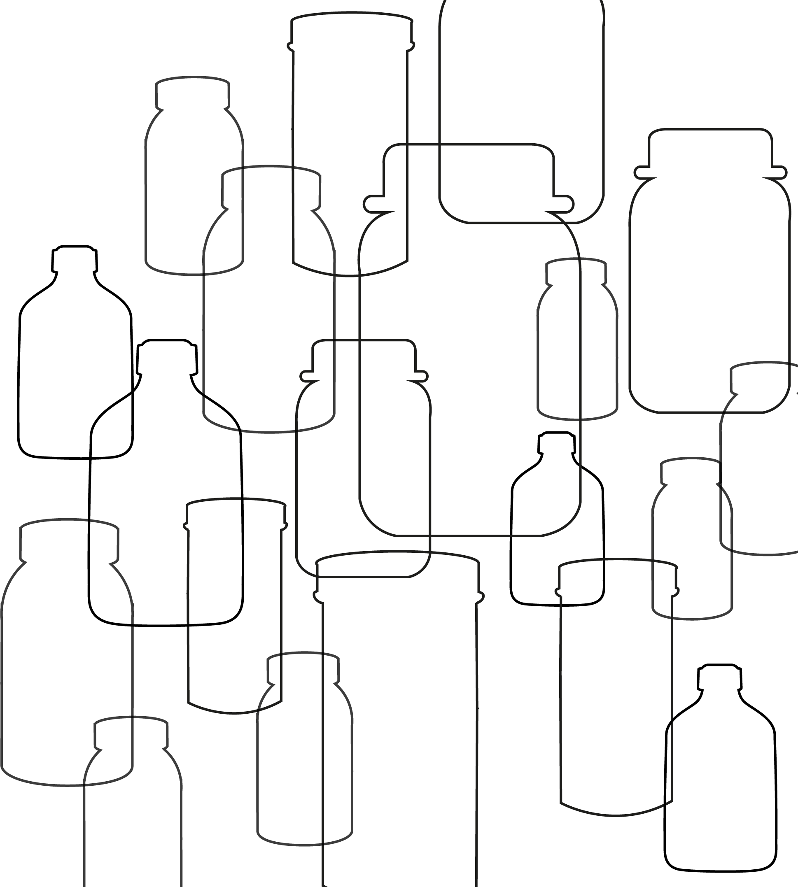

Packaging Pandemic!
Packing it Properly
///////////
A design challenge for you!
This presentation should help you understand how a company like Bayer designs packaging for a new product.
It will also tell you what skills you need in your ‘Design Team’ so that you can share the work out to the most suitable members of the team.
Bayer has a new product and your job is to design sustainable packaging for it!

Slide 2
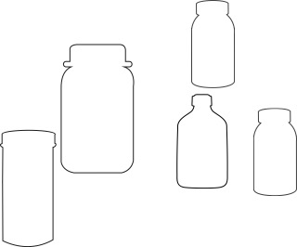
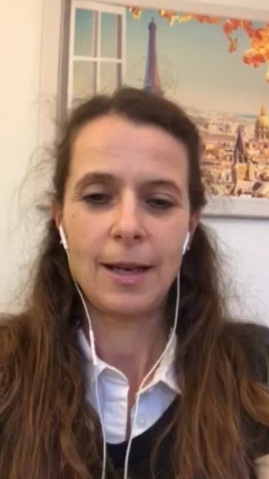
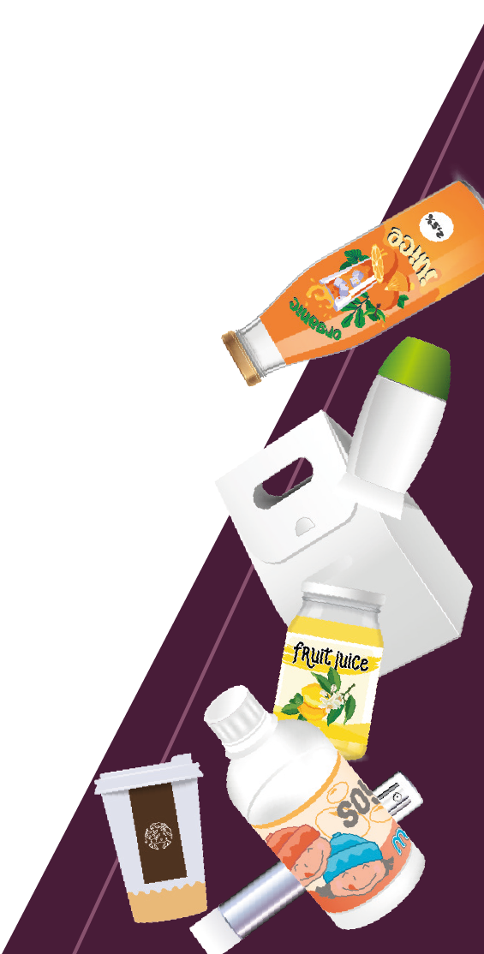
Your Packaging Challenge
// Bayer has an
exciting new
product and
needs to design
sustainable
packaging
for it.
// The new product
is an effervescent
tablet that can
build strength,
health and
alertness.
There are a number of important things that the packaging must do to protect the new product.
The new packaging must:
// Protect the product from being crushed
to a powder.
// Protect the product from the air until the
packaging is opened for the first time.
// Keep the product dry until the customer
is ready to use it.
// Be of a suitable quality for foodstuffs.
/// Bayer 16:9 /// July 2022

Slide 3

The role of packaging
Protect the product
Make the product visible
Preserve the product (shelf-life)
Provide consumer convenience
Reduce product waste
/// Bayer 16:9 /// July 2022

Slide 4
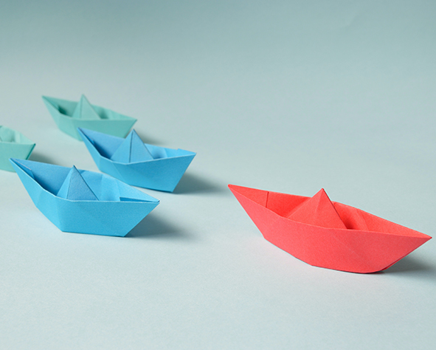





Organising your team – What skills do you need?
Team Leader – Your job is to keep track of how all the team are progressing and have the final say on which packaging you go with.
Sustainability control – Your job is to make sure that the packaging is as sustainable as possible and recommend options based on the 4 R’s.
Researchers – Your job is to look for possible packaging solutions. You may want to see how similar products are packaged.
Communication and messaging – Your job is to make sure the consumer understands what the product is for and why it is for them.
Designers – Your job is to come up with designs for the packaging that help the consumer recognise and choose the product.
WORKING TOGETHER – It is important that everyone in the team has a chance to politely say what they think, including on what other members have produced.

Slide 5

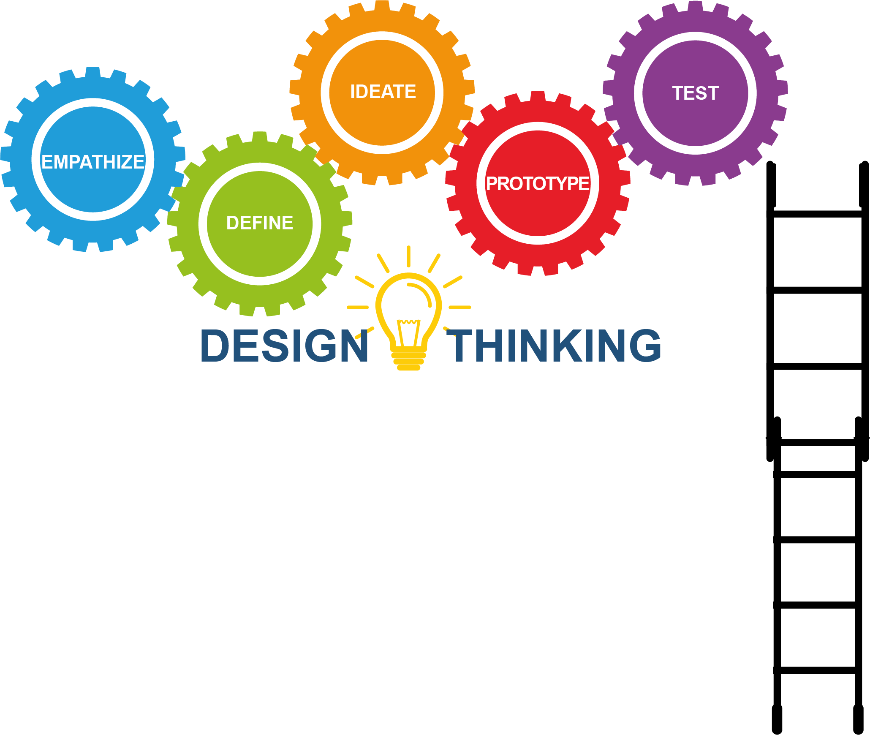

What do we mean by Design Process?
What does my packaging need to do?
What are my packaging options?
How will I test my packaging?
It will be easiest for your team if you follow a design process. This is basically a set of steps to make sure you move towards the best solution to a design problem.
/// Bayer 16:9 /// July 2022

Slide 6
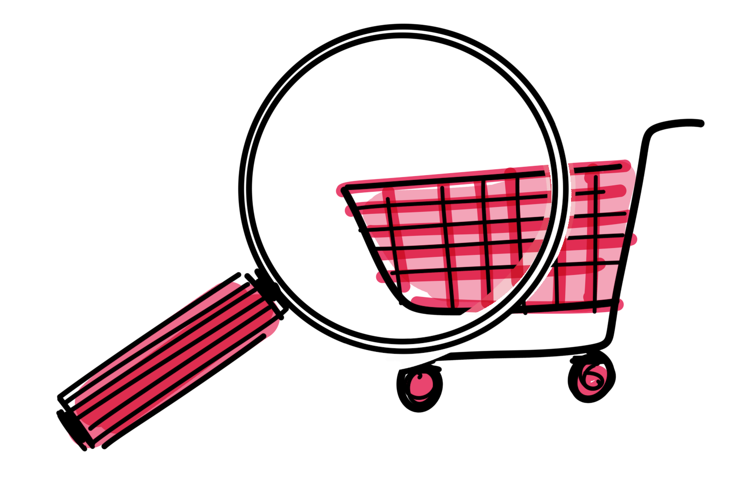

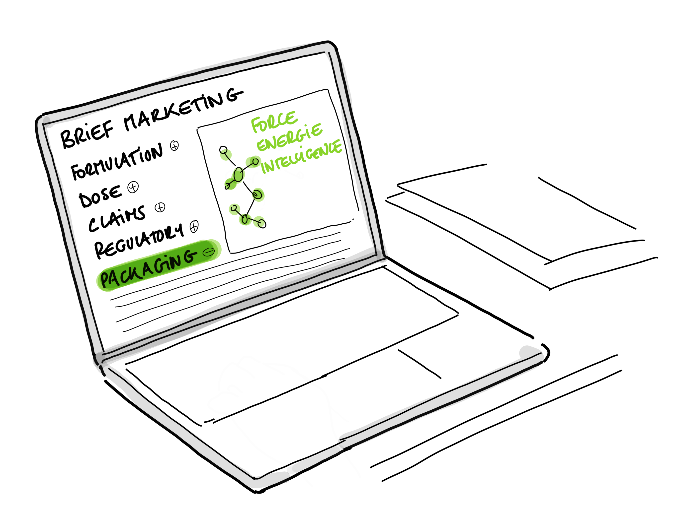



Process chart
INTRODUCTION OF THE PACKAGING TERMINOLOGY AND THE 4 R’S.
PURPOSE OF THE PACKAGING (VIDEO)
AUDIT OF THE COLLECTED PACKAGINGS ALONG WITH THE 4 R’S CRITERIAS
EXPERIMENTATION RESULTS AND SHARE LEARNINGS
ADVISE ON SET UP OF PROJECT GROUPS TO DESIGN PACKAGING FOR A NEW BEROCCA PRODUCT.
IDEAS GENERATION
DRAWINGS
& DESIGN
PROTOTYPING
FULL CONCEPT PRESENTED
STORE VISITS
EXPERIMENTATIONS Packaging degradation
Packaging shelf-life
PACKAGING BRIEF
FROM BAYER
1
2
3
4
CONSUMER
NEEDS
EXPLORATION
ANALYSIS
CREATIVITY
NEXT STEPS
Learn from observations
to understand the subject
Construct a point of view
that is based on
Experiments and insights
Brainstorming
and coming up with
creative solutions to be prototyped.
Packaging qualification
Site transfer
Dossier submission
Production
Project brief and specifications
/// Bayer 16:9 /// July 2022

Slide 7
R
Sustainability
REMOVE
The 4 R’s
R
We have talked about recycling but this is only one of the 4 R’s of sustainability.
These are:
// REMOVE
// REDUCE
// REUSE
// RECYCLE
REDUCE
R
REUSE
R
RECYCLE

