Slide 1
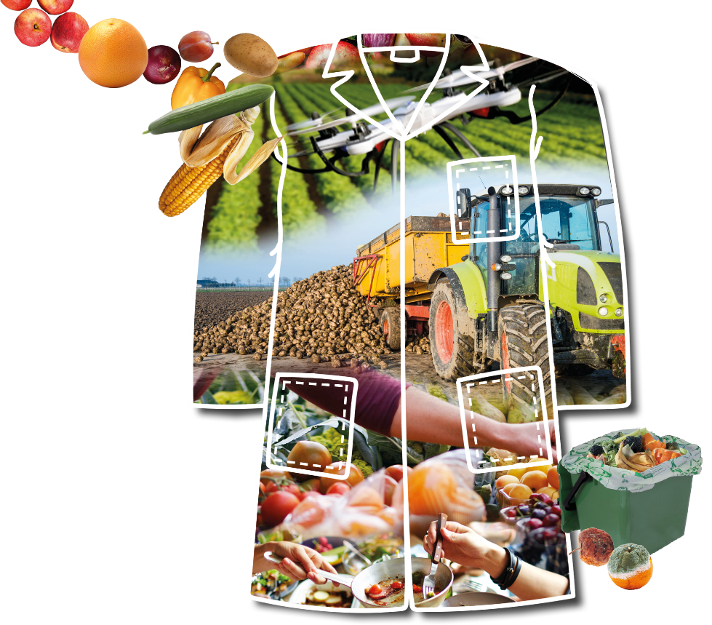
competition
//////////////////////////////////////////////////
2022
Food and Food Waste

Slide 2
// What is a scientist?
// What does a scientist look like?
// Why do we need scientists?
// Quick Quiz!
// Introduction to Bayer Crop Science
// The Baylab Lab Coat Competition!
// Extra Challenge!

Slide 3
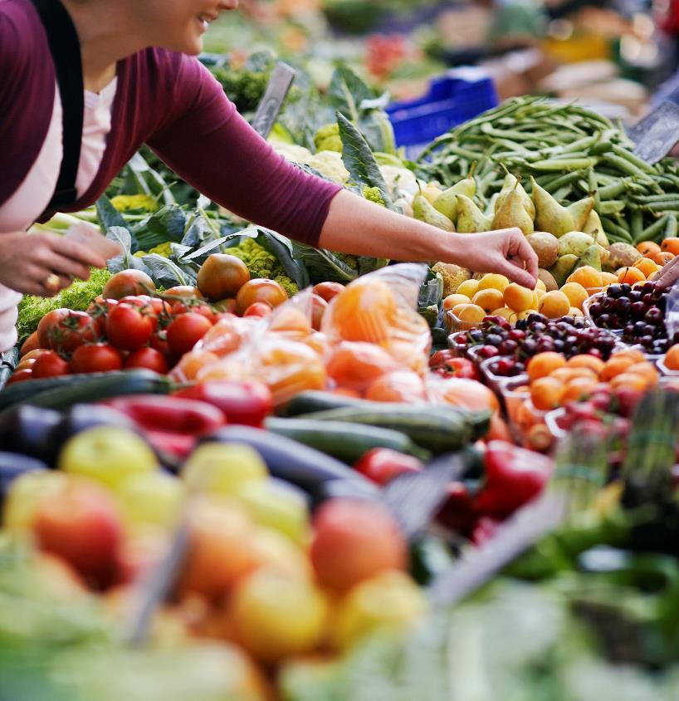
//////////////////////////////////////////////////////////////
Finding the links…

Slide 4
A scientist is ‘a person who conducts scientific research to advance knowledge in an area of interest.’

Slide 5
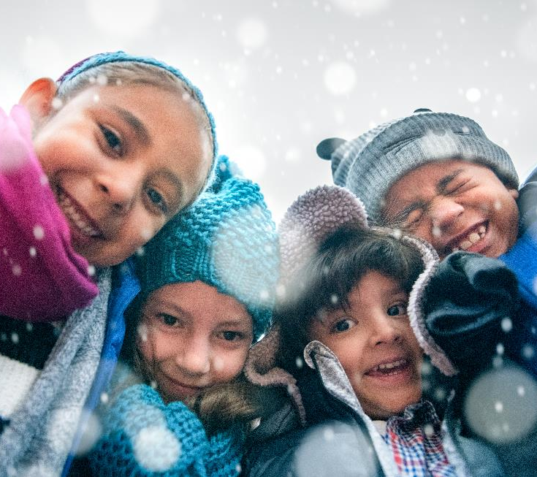
When studying science, you are finding solutions to the world’s biggest problems.
So, scientists find the solutions that save lives!

Slide 6
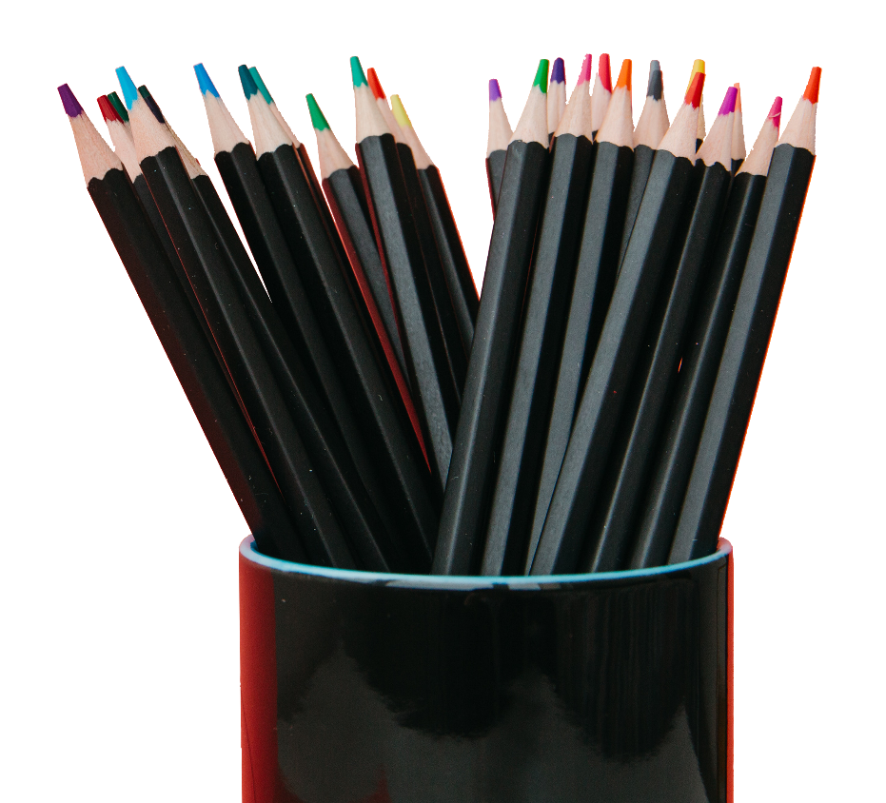
Have a go at drawing
it in groups…

Slide 7
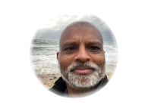
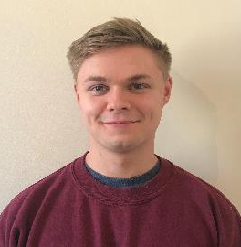
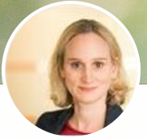
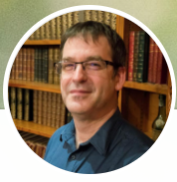
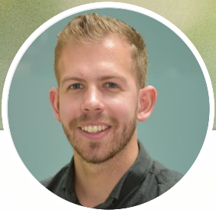
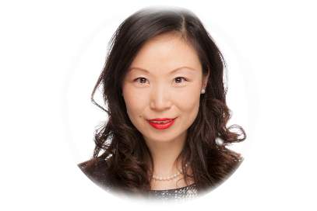
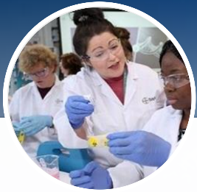
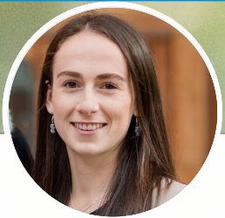
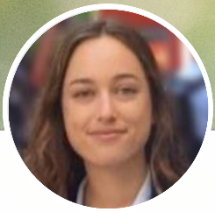
Were you lucky?
Did you get it right?

Slide 8
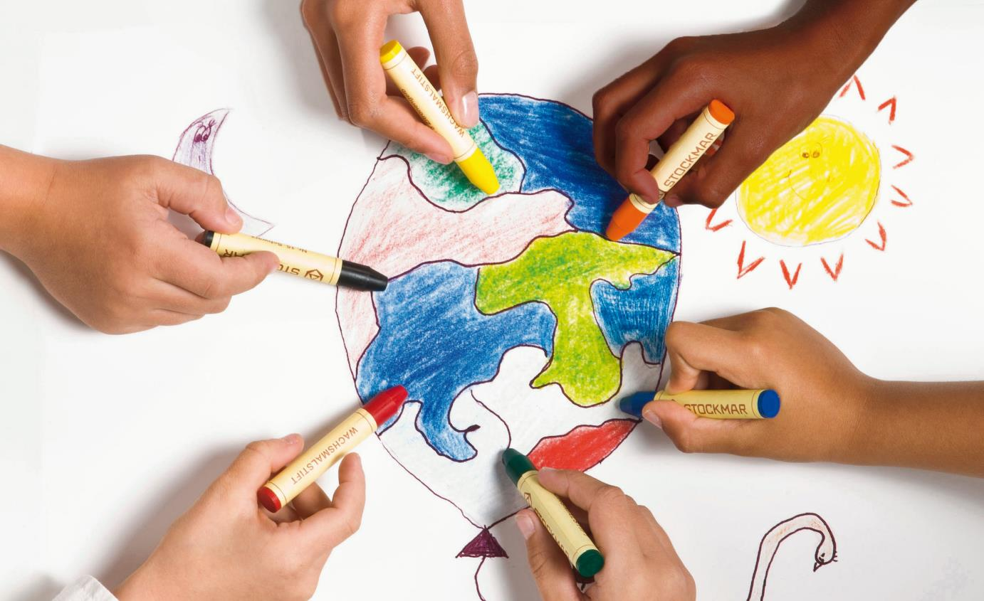
What do you think is the greatest problem facing the Earth today?

Slide 10
Consider rising temperatures, increased rainfall, droughts,
heat waves and hurricanes.

Slide 11
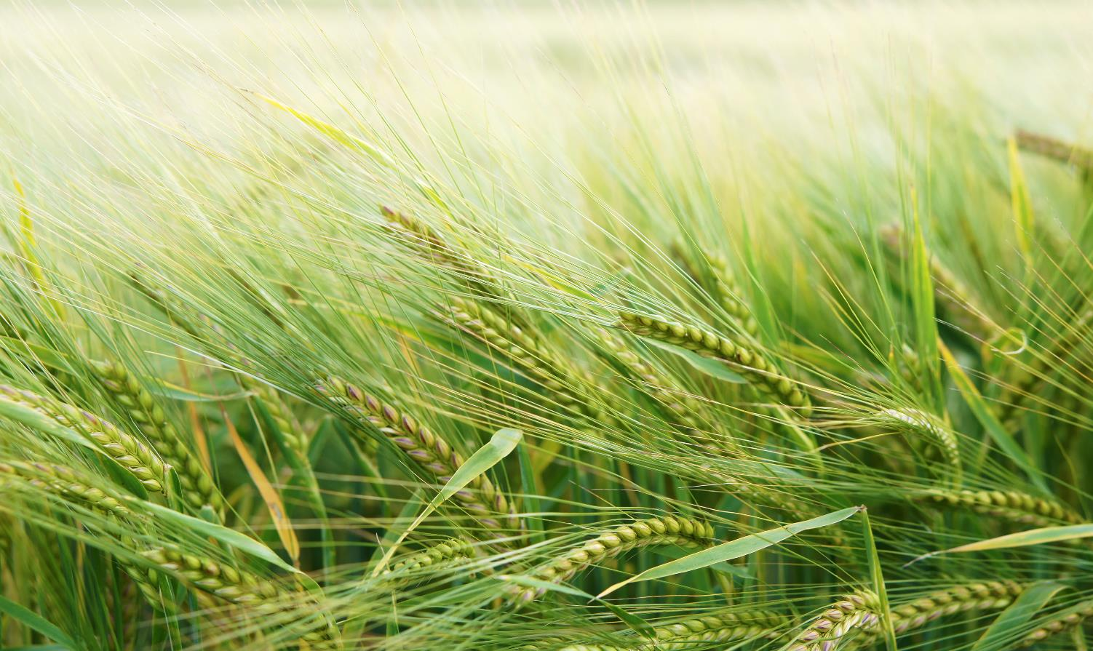
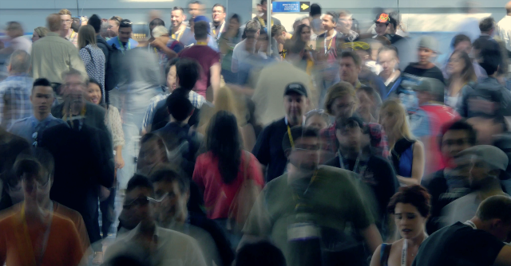
This is predicted to destroy 20% of farmland, and decrease harvests by 17%.
However,
our population
is growing,
not shrinking!

Slide 12
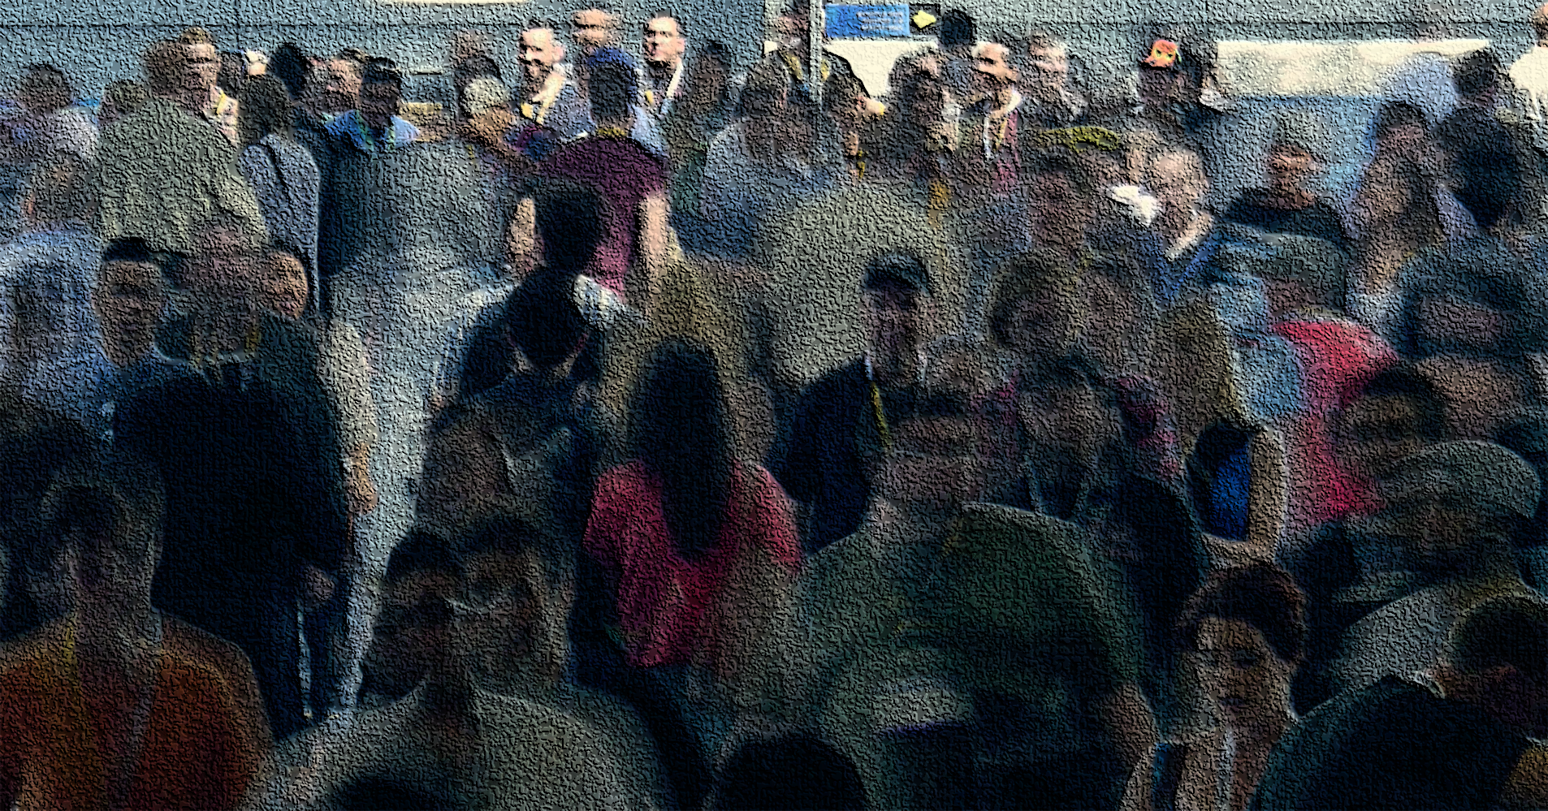
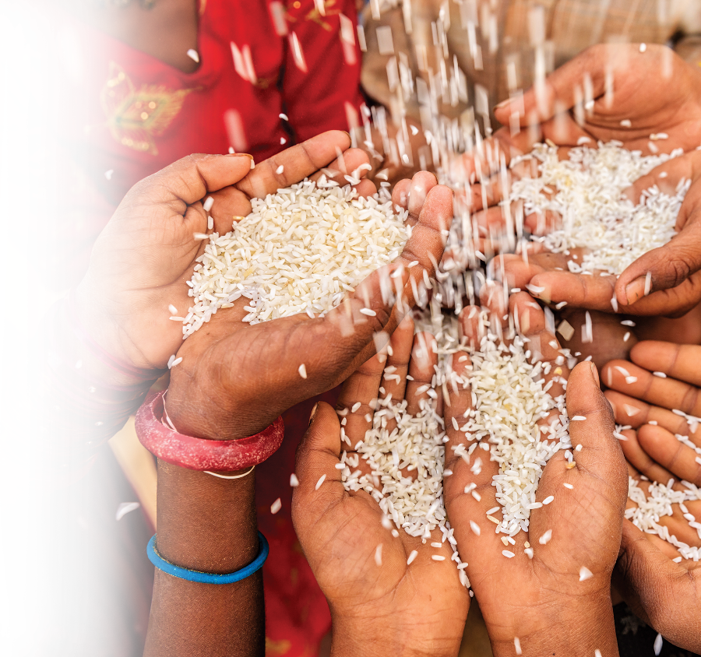
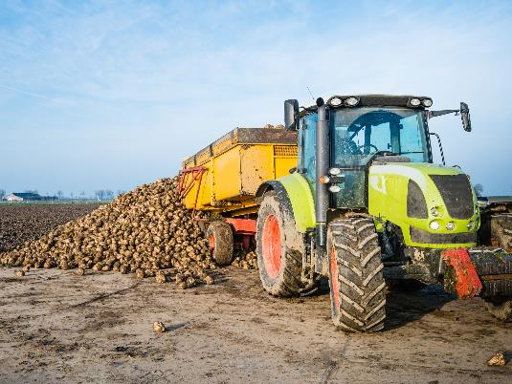
Specifically, there will be about 10 billion people by 2050.
That means that there are going to be a lot more mouths to feed, and stomachs to keep from starving.
We need to start
producing a
whopping 50% more
food than already do…
how on Earth are we
going to manage it!?

Slide 13
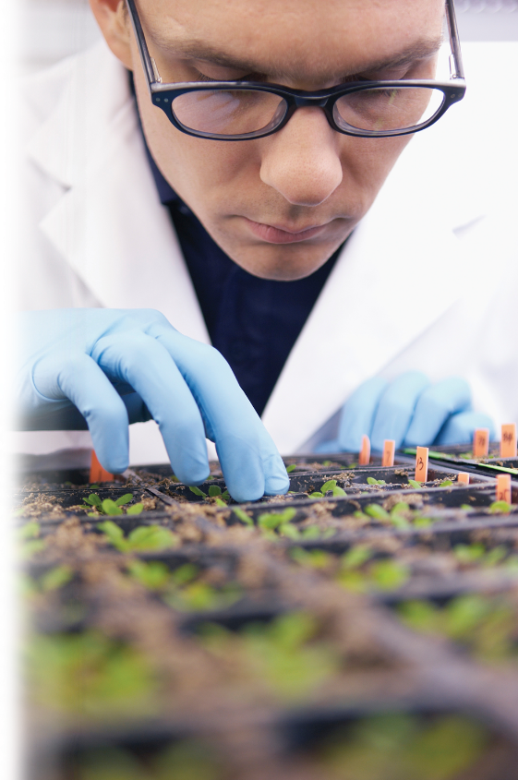
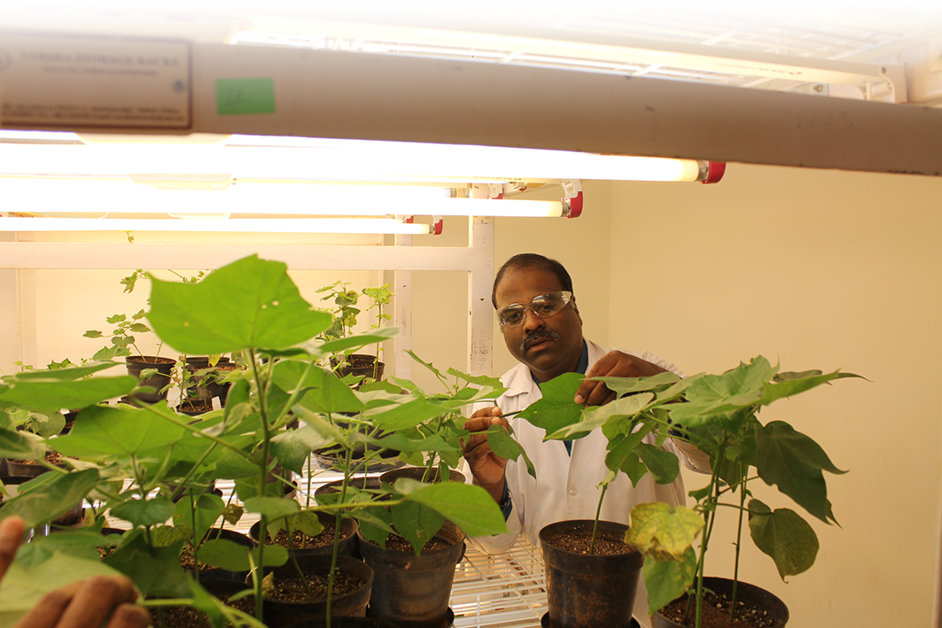
We’re going to solve it through science of course!

Slide 14
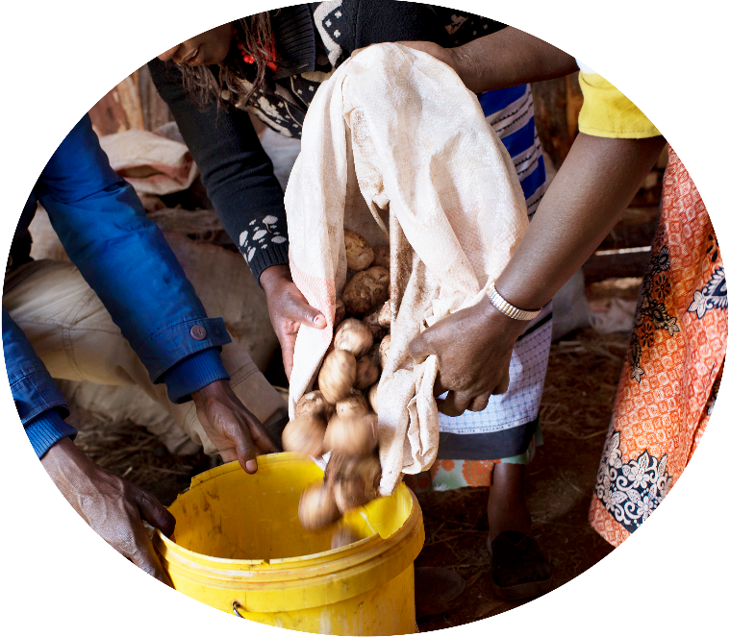
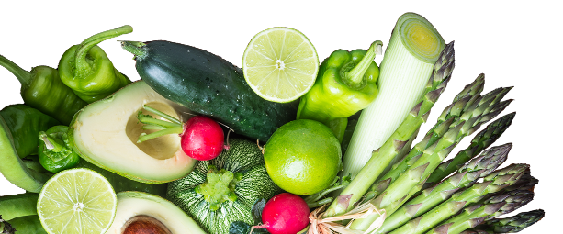
One of the easiest ways to ensure that we have enough food to keep people from
starving is to conserve waste.

Slide 15
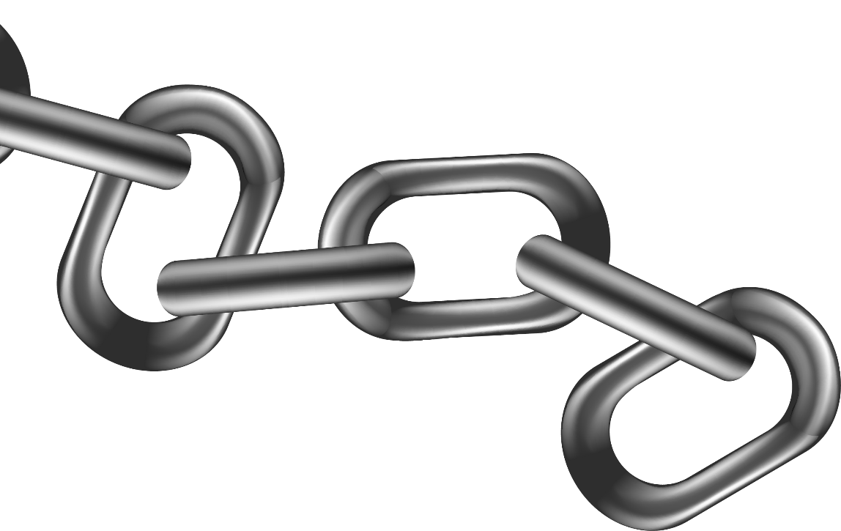
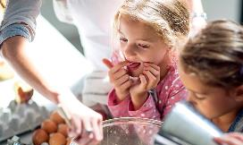
Where does
the food waste
occur?
At the supermarkets
In the fields
In houses

Slide 16
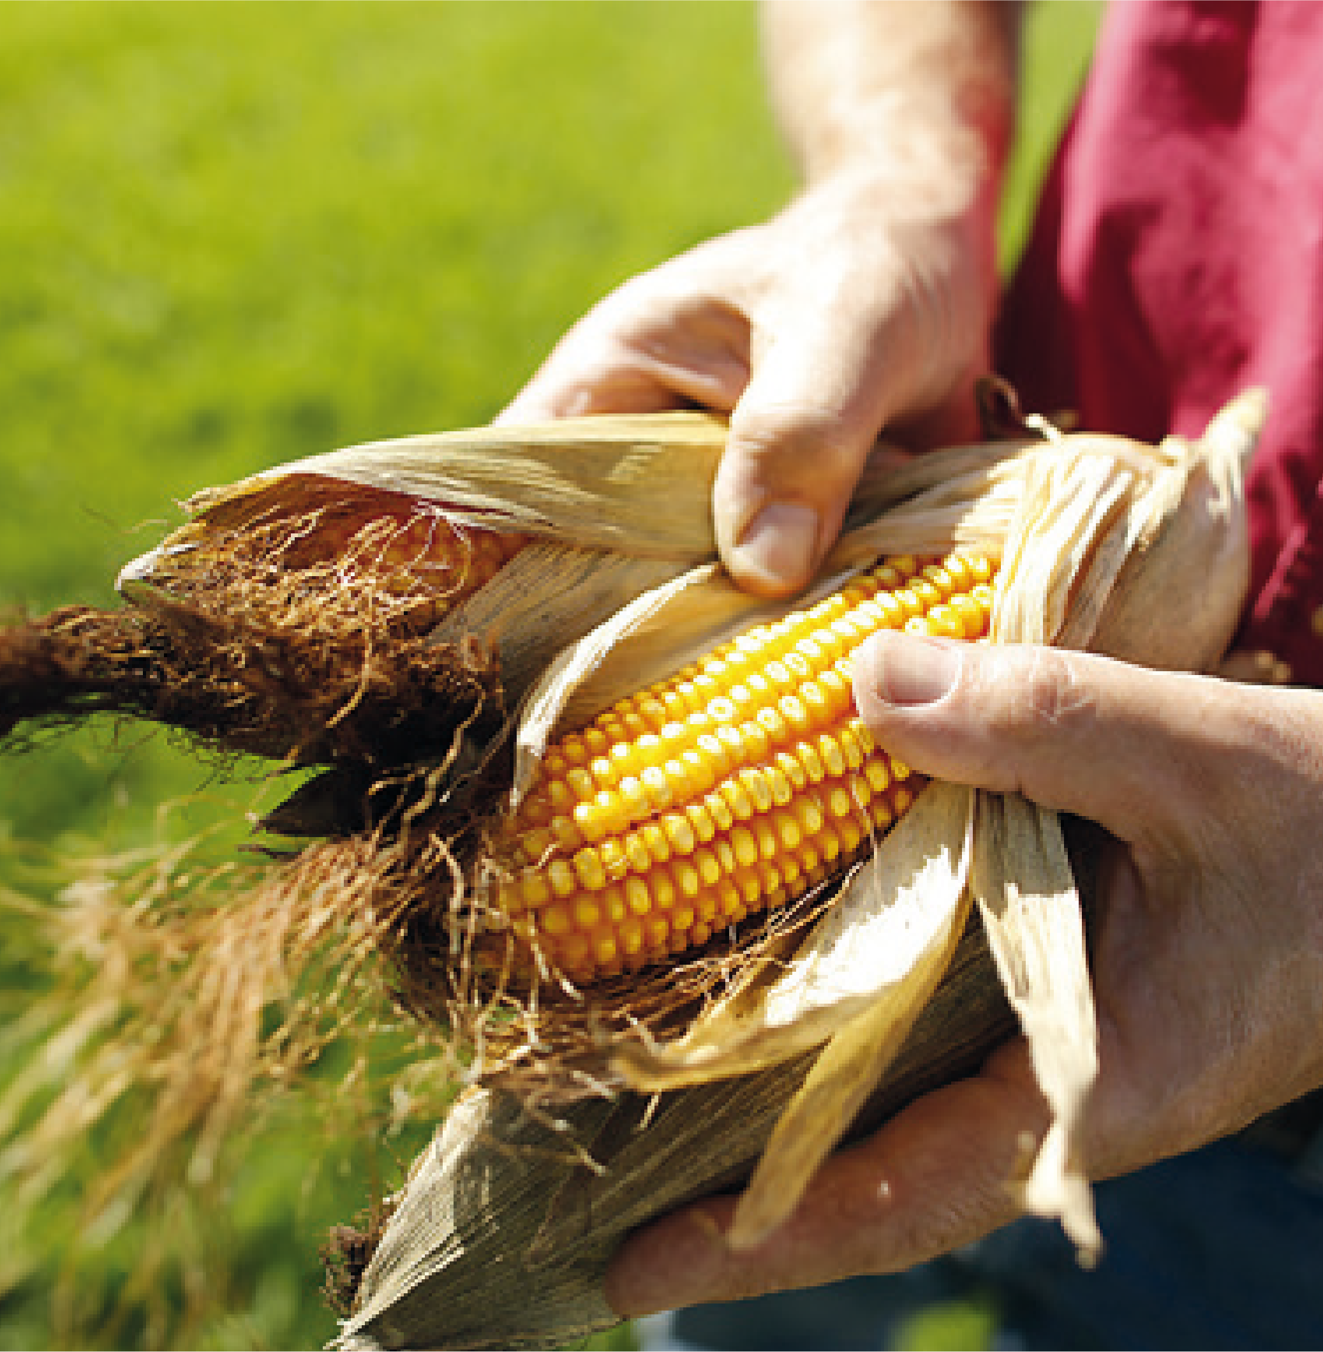
Get your scientist hats on!
// True or False: it is cheaper for companies
to dispose of food as waste than to distribute
it to charities
// What is surplus food?
A. Food that has been put in the bin
B. Food that is edible, but not sold
C. Food that has been composted
D. Food that has passed its sell-by-date

Slide 17
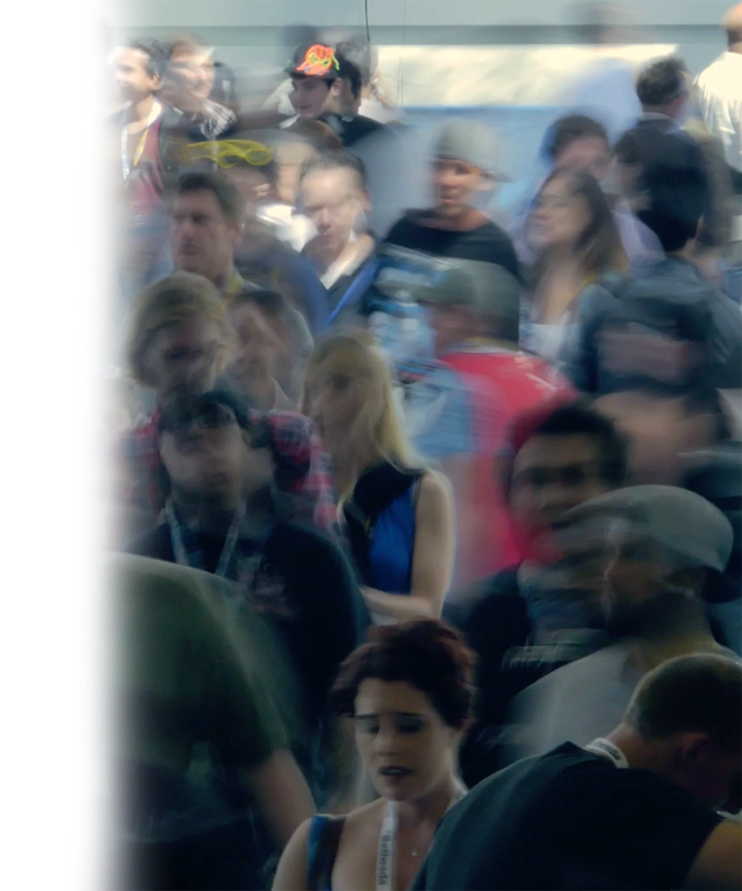
// How many people in the UK go hungry?
1 in 500 - 1 in 30
1 in 100 - 1 in 8
// How can you help reduce food waste?
Freezing food
- Storing food correctly
Trying out preservation methods
- All of the above

Slide 18
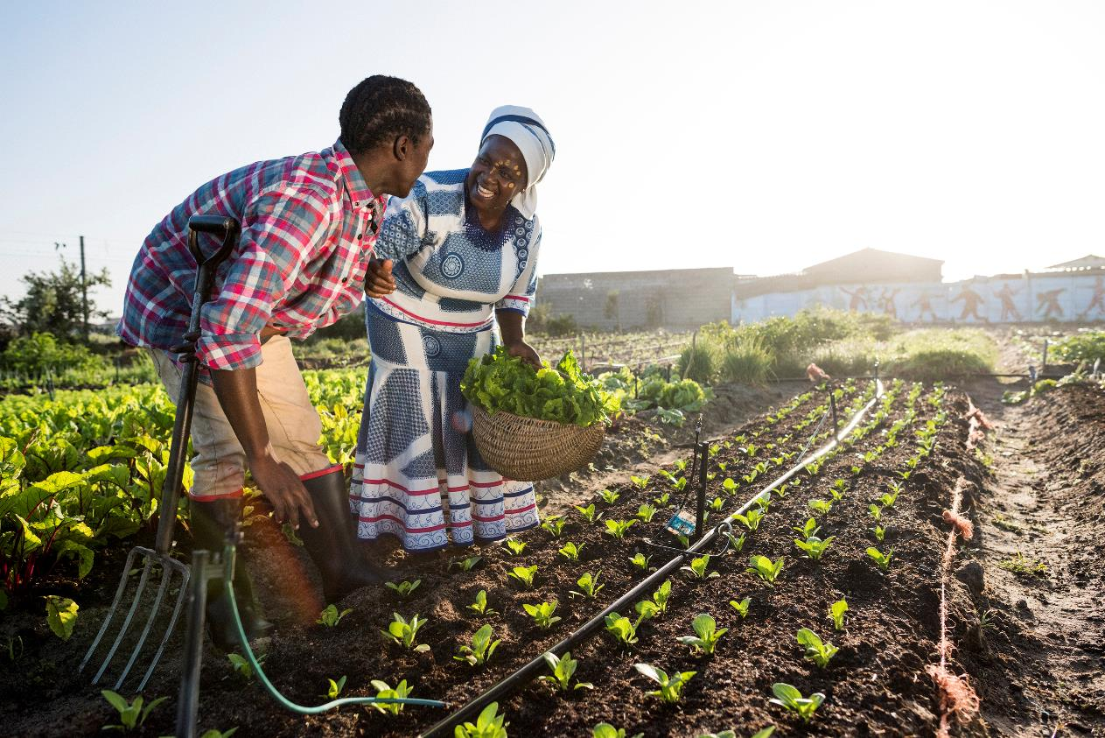
Companies and Charities
//////////////////////////////////////////////////////////////

Slide 19
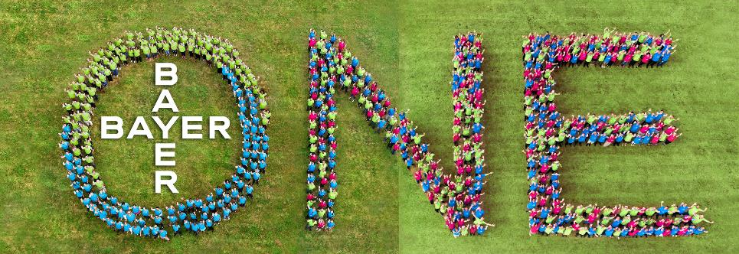
Part of Bayer’s company is the Crop Science Business.
The business is dedicated to finding the solutions that will enable us to feed the world without hurting the climate.

Slide 20
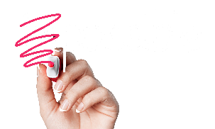
//////////////////////////////////////////////////////////////
Now it’s your turn

Slide 21
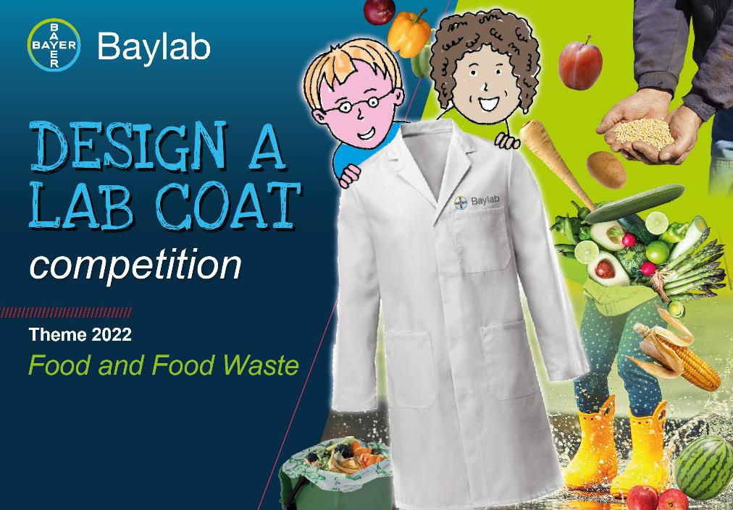
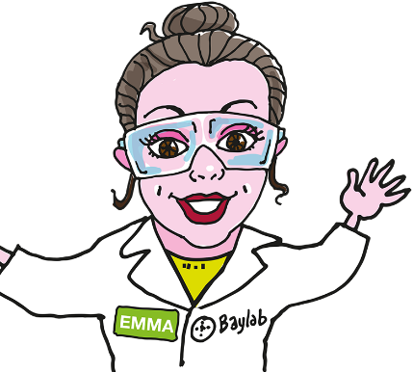
competition
/////////////////////////////////////////////////////////////////////

Slide 22
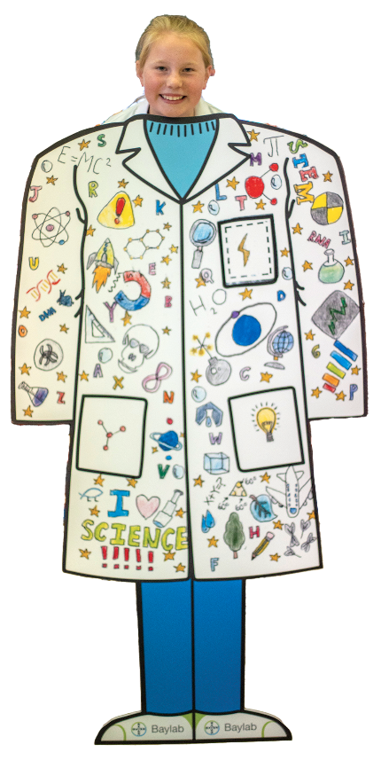
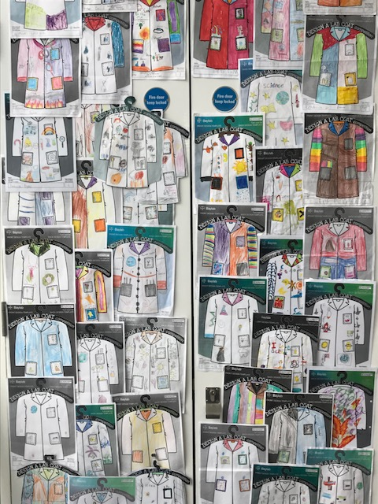
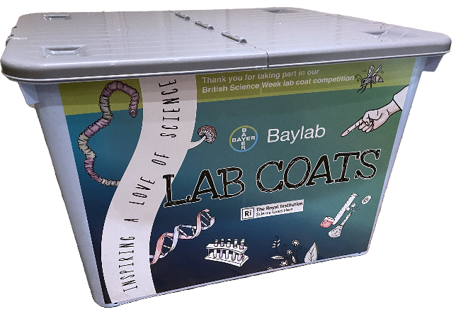
Example of previous year’s designs
competition
/////////////////////////////////////////////////////////////////////
INFANT | JUNIOR | SENIOR

Slide 23
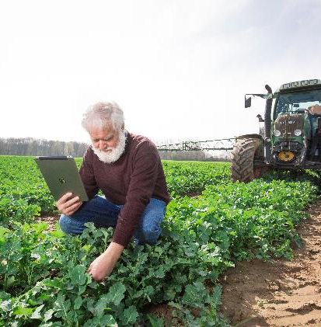
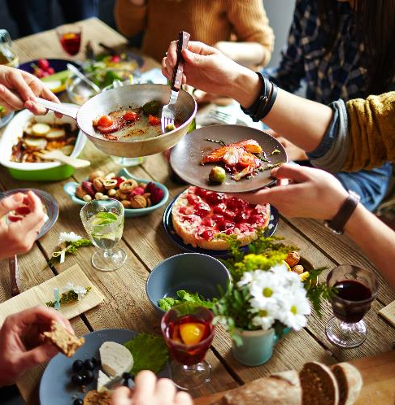
This year is the 5th anniversary of
the Baylab’s lab coat competition!
So, for this year and all the following,
we’re introducing a twist!
Competitions will now officially
be themed.
This year’s theme will be food and food waste.
/////////////////////////////////////////////////////////////////////

Slide 24
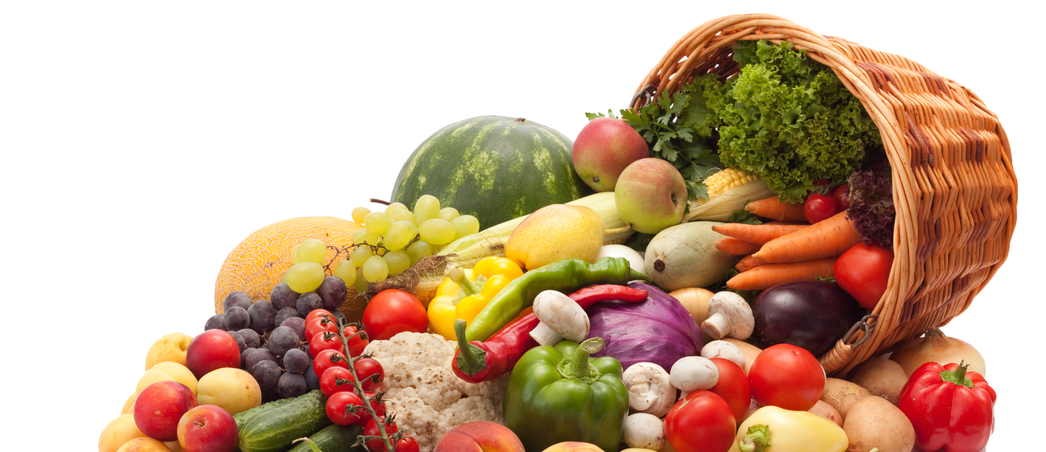
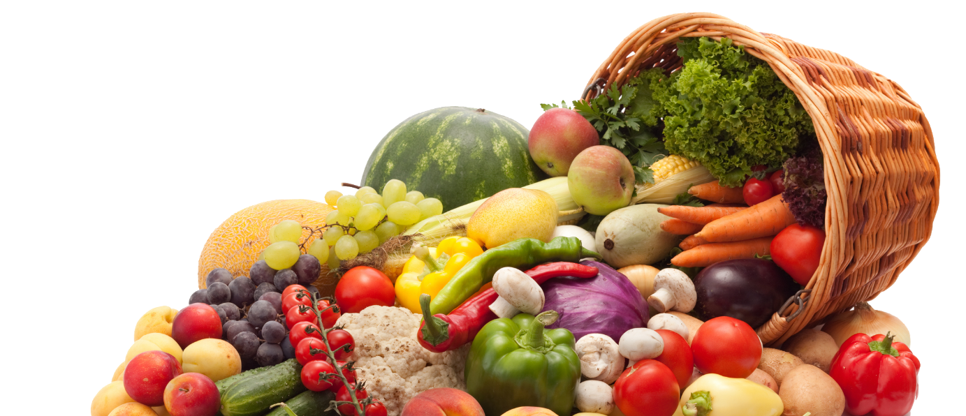
Write down all the times you wasted food
in the past week

Slide 25
1. Always make a shopping list so you don’t over buy
2. Organizing the kitchen with first in first out
3. Store food correctly. Do you know where to find this information?
4. Meal plan, make a weekly menu
5. Freeze extras – your freezers your friend
6. Eat leftovers

Slide 26
Use by – you have until the end of this date to use or freeze before it becomes too risky to eat
Best-before – You can eat food past this date, but it might not be at the best quality

Slide 27
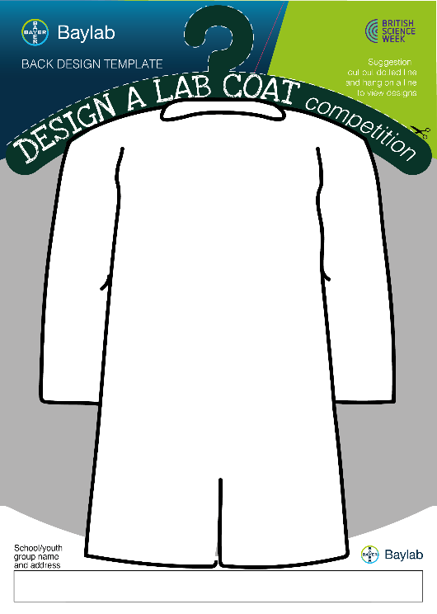
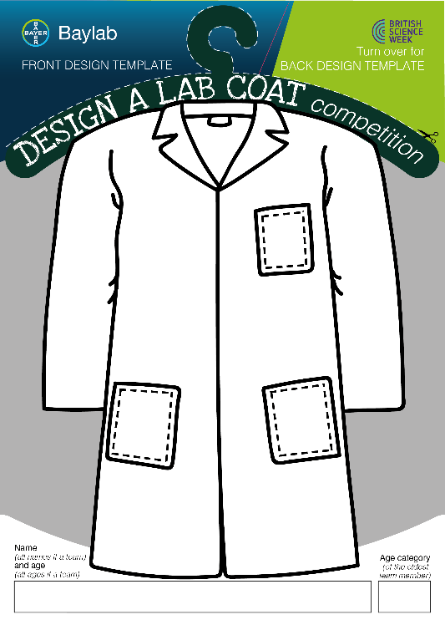
INFANT
|
JUNIOR
|
SENIOR

Slide 28
To be in with a chance of winning, all you need to do is design a lab coat around the theme of food and food waste.

Slide 29
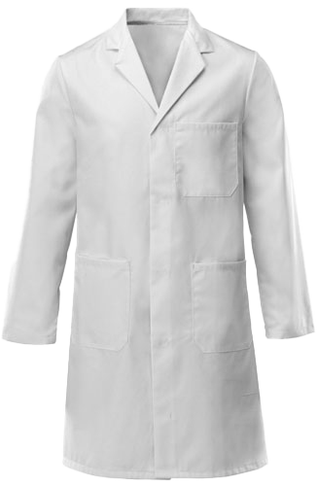
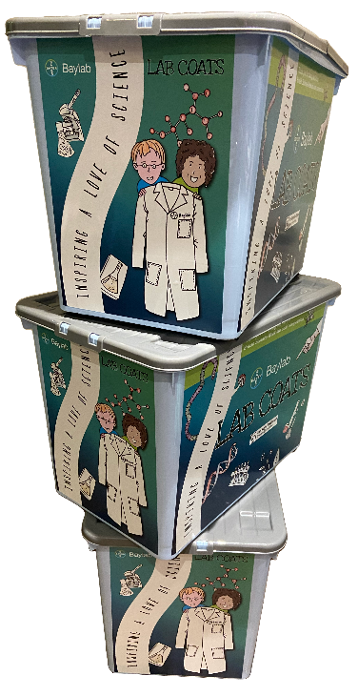
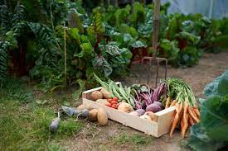
The winner
will get:
A grow your own
veg kit, and a set of lab coats for
your school
/////////////////////////////////////////////////////////////////////
There are
also runners-up
prizes, too!
INFANT | JUNIOR | SENIOR

Slide 30
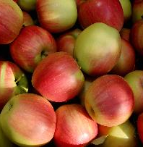
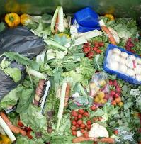
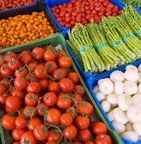
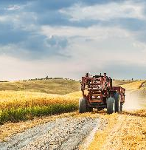
Your favourite food
For example, you could include…
Food and
Food Waste
How food is wasted
Food and farming
Food groups

Slide 31
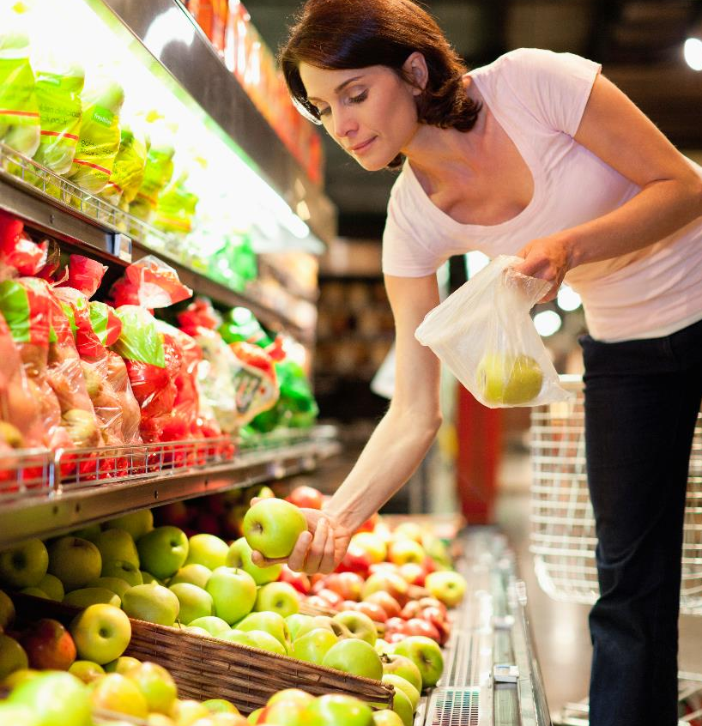
//////////////////////////////////////////////////////////////
Fun-raise to make a difference

Slide 32
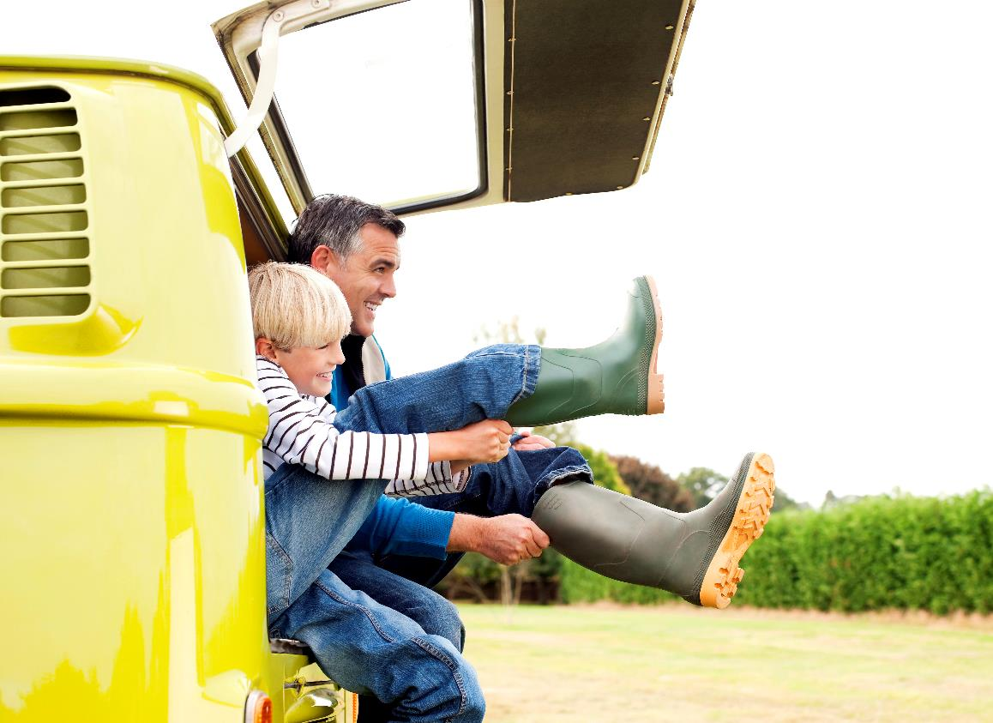
Why not take a stand against food insecurity by donning your wellies this March?
In recognition of farmers
and in aid of charities who
provide access to food for
those in need, the
Baylab has created
a Wacky Wellies
Fun-raiser!

Slide 33
Wear your wellies to school as they come, upcycled, or by blinging them
Share your snazzy feet with
us on Instagram or Twitter to be
entered into our awesome competition!

Slide 34
Up for grabs*:
On-farm visits delivered by LEAF Education, the leading farm education charity: https://leaf.eco/education/
Or a vegetable plot for your school, plus a visit from our educational team and farming professionals.
*Prizes available depend upon school location and the teams involved.
Share your snazzy feet with us on Instagram or Twitter, by tagging @bayer4cropsuk and @leaf_education, with #WackyWellies to be entered into our competition!

Slide 35
// A scientist is someone who advances knowledge.
// If you like something, the chances are you know a bit about it.
// To do that, you have had to advance your knowledge.
// In this sense, we are all scientists, and everything we take an
interest in around us is science.
// Think about the problems humans face right now, and the ones
we will face in the future...
// Could you be the one that solves them?

Slide 36
//////////////////////////////////////////////////
Bye-bye

