Slide 1
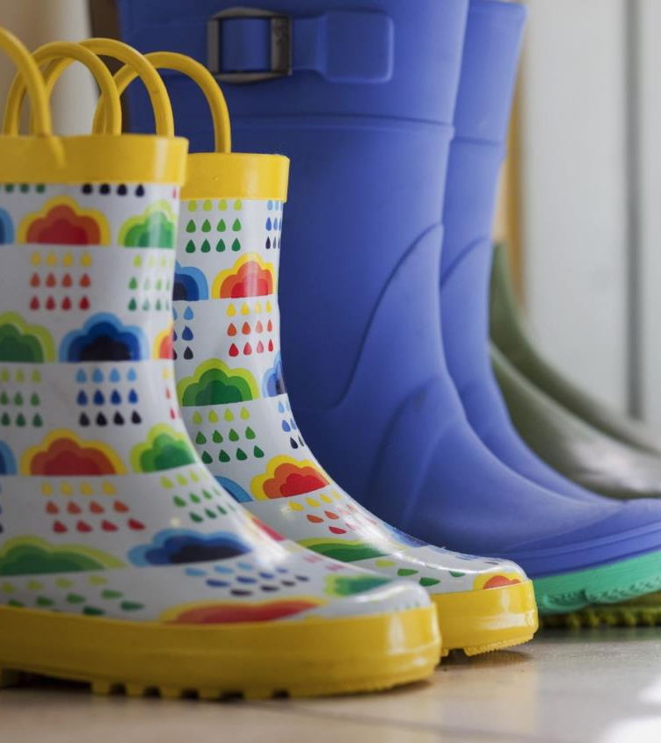
Pull up your boots for
//////////////////////////////////////////////////
A fun-raiser like no other…

Slide 2
The Power of Farmers
We owe farmers
a LOT.
More than 80% of the food in your fridge, right now, wouldn’t be there without a farmer.

Slide 3
However!
3.6 million tonnes of this food is wasted, in the UK, every year,
2 million of which is edible

Slide 4
How can
you help…?
Through
Wacky Wellies,
of course!
Have a go at drawing
it in groups…

Slide 5
How to get involved?
Give a suggested donation of £1 and wear your wellies to school, either as they come or bling them up; the wackier, the better! All the money you raise will be used to support charities that strive to end hunger and food poverty in the UK.

Slide 6
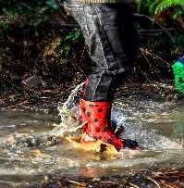
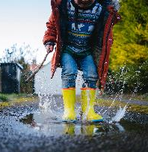
Up for grabs*:
On-farm visits delivered by LEAF Education, the leading farm education charity: https://leaf.eco/education/
Or a vegetable plot for your school, plus a visit from our educational team and farming professionals.
*Prizes available depend upon school location and the teams involved.
You can even share your snazzy feet with us on Instagram or Twitter, by tagging @bayer4cropsuk and @leaf_education, with #WackyWellies to be entered into our competition!*

Slide 7
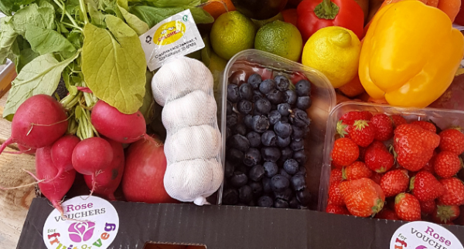
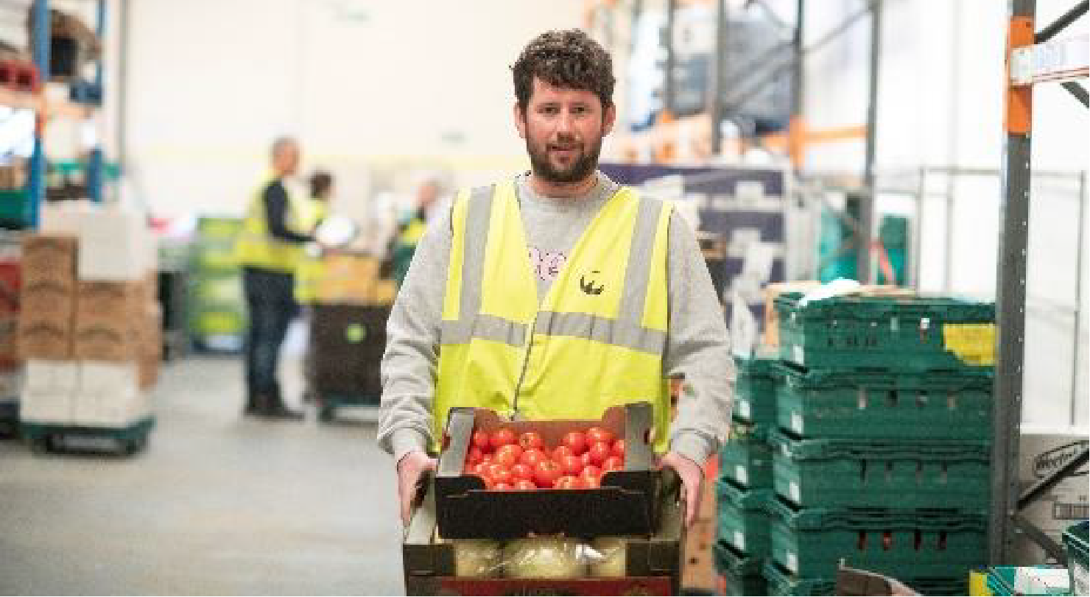
The Charities
Choose a charity you’d like to support. The choice is completely yours:
Alexandra Rose – ‘Our vision is for everyone to have access to healthy and affordable food, giving families access to fresh fruit & vegetables in their communities.’
Feeding Britain – ‘Our vision is a UK where no one goes hungry.’
FareShare – ‘We believe that no good food should go to waste by redistributing surplus food to charities that turn it into meals.’
Other – Another charity working to provide access to food for those in need.

Slide 8
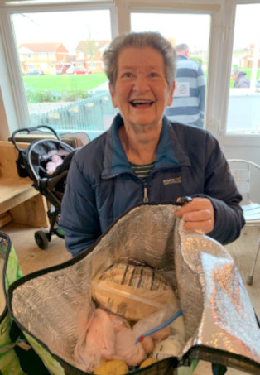
How your donations
make a difference

Slide 9
Good luck!
//////////////////////////////////////////////////

